Slide 1
Anzisha Fellow Directory

Slide 2
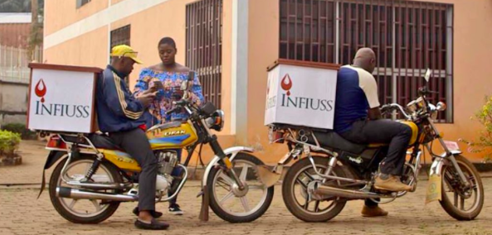
COVID - 19 BUSINESSES SUPPORT:
As Anzisha fellows and their employees, beneficiaries and partner organizations weather this unprecedented Pandemic, The Anzisha Prize Program has compiled the fellow directory for our community to identify opportunities to support fellow businesses.
The coronavirus or COVID-19 pandemic has caused massive disruption for businesses in our community. Shops and businesses are closed or not operating as usual and many people are not working or are working remotely.
The immediate and long-term needs of Anzisha fellow businesses are of utmost importance right now. Many communities rely on them. Not only for the services and goods they provide, but the jobs they create and the numerous contributions they, their employees and their families make to the economy of the communities they operate in.
These are unprecedented times, but we are optimistic that Anzisha fellow run businesses will bounce back.
We encourage you to look through this directory for a list of all the fellow businesses in our community and to reach out to those you believe you are best positioned to extend support to.

Slide 3
Want to assist but not sure how? Some Ideas
1
4
SHOP EARLY
If you’re in a financial position to do so, go ahead and complete shopping now that you would typically wait to do for a few months.
LEAVE A POSITIVE REVIEW ONLINE
Leave a positive review online — We’ve all headed to Google, Yelp, Tripadvisor and other review services to get the lowdown on a small business. These reviews have incredibly tangible impacts on a business. Take a few minutes and leave your favorite small businesses a positive review.
2
5
GIFT CERTIFICATES
Buying gift cards gives a small business a cash infusion now to make it through hard times. The gift certificate can be used by yourself or to qualify their regular customers to redeem the product or service in the future.
MARKET FOR A BUSINESS
We each have our own in-person and virtual communities of influence and now is the time to utilize them. Tell your friends, colleagues, family and neighbours who to support and be vocal about it.
3
6
EMPLOYEE RETENTION GRANT DONATION
The greatest concern for most business owners, at least initially, is how am I going to pay my bills this week, next week, and how long will this last. Donate funds to enable business owners to cover employee salaries in order to avoid letting go of people and contributing to the growing unemployment rate.
HOST AN ONLINE MASTERCLASS
Share your expertise with small business owners on some creative ways to adjust their business models. We’ve heard od a local painting studio for kids selling take-home art kits you can organise for pickup or delivery. Help brainstorm how small businesses can make their products mobile or virtual.

Slide 4
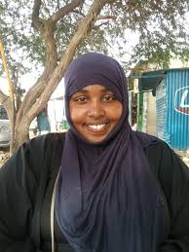
Asia Saed– 2Doon: Youth development
NAME OF BUSINESS: 2Doon
BUSINESS ACTIVITIES: 2Doon is a social enterprise that aims to reduce youth unemployment in Somalia. They do this by offering services such as compiling CVs and providing training sessions and workshops to help youth gain relevant employment skills.
BUSINESS LOCATION: Somalia
JOBS CREATED (Full & Part Time): 113
CONTACT DETAILS
Contact: Asia Saed
Website: https://instagram.com/2doon2018
Email: asiasaed03@gmail.com
WhatsApp: +252 63 467 4100
ABOUT ASIA
After seeing how her classmates and other youth struggled to find jobs after completing university, Asia decided to take action and founded 2Doon. Asia strives to revitalize the landscape of youth employment in Somalia.

Slide 5
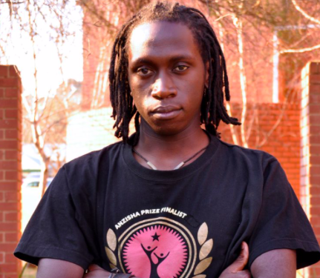
Isaac Oboth – African Storytellers: Film-makers
NAME OF BUSINESS: African Storytellers
BUSINESS ACTIVITIES: African Storytellers produces positive content about Africa and Africans, distributing this content with international mainstream media.
BUSINESS LOCATION: Uganda
JOBS CREATED (Full & Part Time): 10
CONTACT DETAILS
Contact: Isaac Oboth
Website: www.africanstorytellers.com
Email: ioboth@africanstorytellers.com
WhatsApp: +256 793 337034
ABOUT ISAAC
Isaac’s love for photography and media began during his high school prom when he decided to make a digital alumni album. Since then, his business now has clients such as USAID, UNDP, Althea, African Leadership Academy and Coca Cola. One of its most celebrated works is Discover Uganda - a ten-part series that was very successful in multiple African countries and was later aired by a US cable outlet.

Slide 6
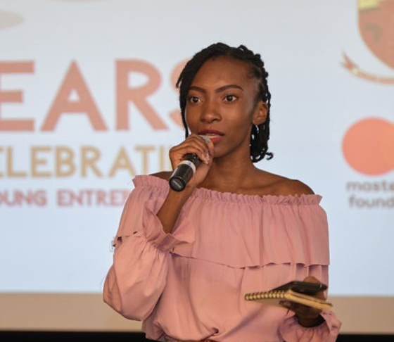
Khondwani Banda – Afford-a-Baby: Affordable children’s clothing
NAME OF BUSINESS: Afford-a-Baby
BUSINESS ACTIVITIES: Afford-a-Baby provides affordable children's clothing for low and middle income families.
BUSINESS LOCATION: Zambia
JOBS CREATED (Full & Part Time): 5
CONTACT DETAILS
Contact: Khondwani Banda
Website: https://www.linkedin.com/in/kondwani-banda-aa7a59140/
Email: khondwanijounalism@gmail.com
WhatsApp: +260 977 643 703
ABOUT KONDWANI
Kondwani is a media and communications major at the University of Zambia. A natural born storyteller, Kondwani initially found her calling in media and went on to found The Mainstream, a digital magazine that aims to tell authentic African stories. Since then she has started another media enterprise –Verity Network.

Slide 7
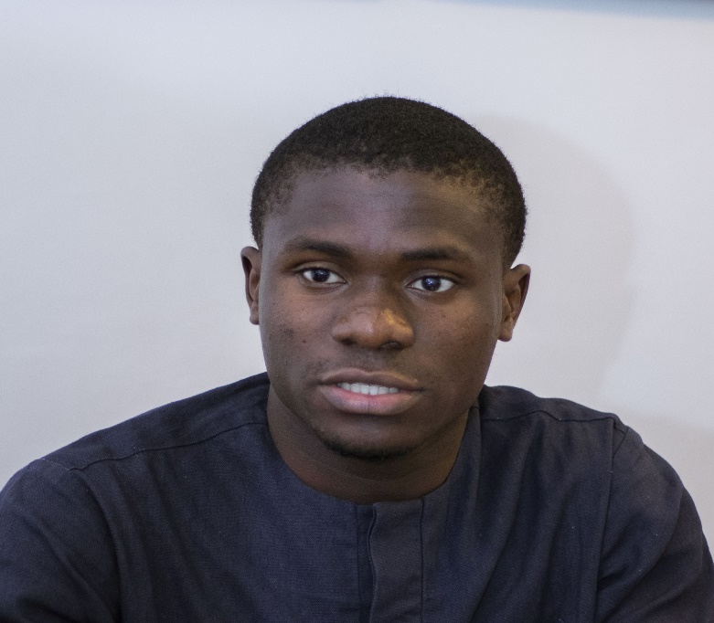
Aldred Dogue – Africa Foods Mill Ltd: Pre-cooked fruits & vegetables
NAME OF BUSINESS: Africa Foods Mill Ltd. (AFM)
BUSINESS ACTIVITIES: AFM purchases local agricultural produce from smallholder farmers. This produce is then transformed and packaged into convenience foods, such as ready-to-eat fresh vegetables, frozen vegetables, cut fruits and fruits salad.
BUSINESS LOCATION: Benin
JOBS CREATED (Full & Part Time): 6
CONTACT DETAILS
Contact: Aldred Dogue
Website: https://www.facebook.com/africafoodsmill
Email: aldreddogue@gmail.com
WhatsApp: +229 961 523 99
ABOUT ALDRED
Aldred has a degree in Nutrition and Food Technology. He started AFM after he found that local farmers were experiencing post-harvest losses. He joined, AIESEC, a leadership organization and has worked with them on education and gender equality projects. In recognition of his company’s success, he received the Best Business Plan Award from the Young People’s Chamber of Commerce in Benin.

Slide 8
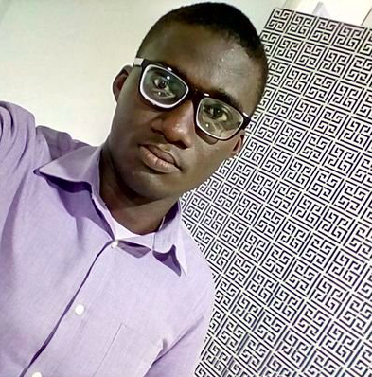
Yaw Duffour – Agripool: Social crowd-farming platform
NAME OF BUSINESS: Agripool
BUSINESS ACTIVITIES: AgripoolApp is a crowd-farming, agritech platform that allows individuals to become farm owners and enjoy regular returns on their investment after the sales of harvested farm produce.
BUSINESS LOCATION: Ghana
JOBS CREATED (Full & Part Time): 30
CONTACT DETAILS
Contact: Yaw Duffour
Website: https://agripoolapp.com
Email: yduffour@agripoolapp.com
WhatsApp: +233 26 342 0552
ABOUT YAW
Yaw is a serial entrepreneur who founded his first business at 16 – the business provided soft loans, financial literacy training, and a savings plan to his peers. He is an Engineering graduate from the Ghana Telecom University. Yaw also has a vast amount of experience working in the financial services, agricultural, and telecommunications industry.

Slide 9
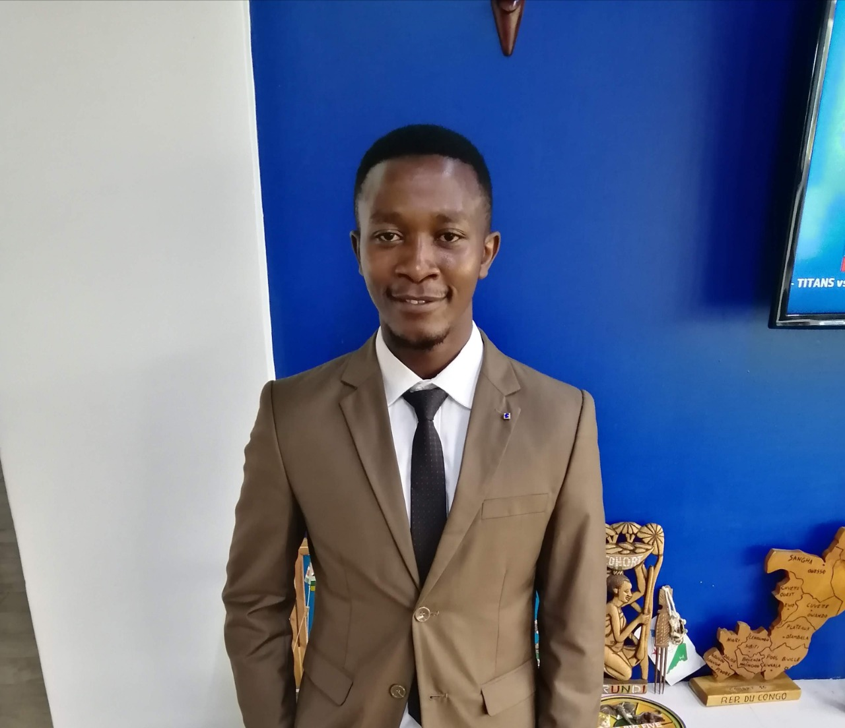
Gerald Matolo – Angaza Africa Technologies: Briquette production
NAME OF BUSINESS: Angaza Africa Technologies
BUSINESS ACTIVITIES: Angaza Africa Technologie focuses on the fabrication of briquette-machines, the construction of solid waste carbonization kilns, and the processing of biomass briquettes.
BUSINESS LOCATION: Kenya
JOBS CREATED (Full & Part Time): 10
CONTACT DETAILS
Contact: Gerald Matolo
Website: https://facebook.com/AngazaEnergy
Email: geraldmuli7@gmail.com
WhatsApp: +254 719 749 633
ABOUT GERALD
Gerald Matolo is the founder and CEO of Angaza Africa Technologies. He is an Electrical Engineering student. In addition to his involvement in Angaza, Gerald is a full-stack web developer and is proficient in python programming. Gerald is an Anzisha Fellow, a Tony Elumelu Entrepreneurship Fellow, and a One Young World Ambassador.

Slide 10
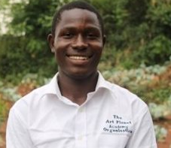
Ignatius Ahumuza – Art Planet Academy: Agricultural training
NAME OF BUSINESS: Art Planet Academy
BUSINESS ACTIVITIES: Art Planet Academy is a school that trains school children on agricultural practices and connects farmers to the market.
BUSINESS LOCATION: Uganda
JOBS CREATED (Full & Part Time): 10
CONTACT DETAILS
Contact: Ignatius Ahumuza
Website: https://www.linkedin.com/in/prince-ahumuza-ignatius-26141140/
Email: ahumuzaignatius@rocketmail.com WhatsApp: +256 755 151 527
ABOUT IGNATIUS
Ignatius was born in a large family of 18 children in a small poverty-ridden village in Masindi, Uganda. Because his family’s livelihood and his upbringing depended on peasant farming, him and his siblings were encouraged to become farmers. In 2018, he was invited to speak at the International Board of Food and Agricultural Development meeting in Washington DC. He is a YALI East Africa Regional Leadership Center Fellow.

Slide 11
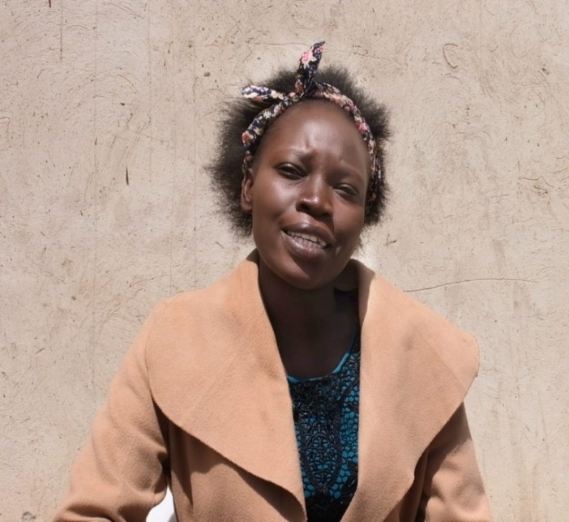
Olipah Chomba– Apex Poultry: Poultry enterprise
NAME OF BUSINESS: Apex Poultry
BUSINESS ACTIVITIES: Apex Poultry is a poultry enterprise which orders broiler chicken and nurtures them for a six-weeks, by providing them with the necessary vaccines and medicine. When the poultry is ready they inform and sell it to their consumers, namely (marketers and restaurants).
BUSINESS LOCATION: Zambia
JOBS CREATED (Full & Part Time): 4
CONTACT DETAILS
Contact: Olipah Chomba
Website: https://anzishaprize.org/fellows/olipah-chomba
Email: olipahchomba107@gmail.com WhatsApp: +260 974 970 373
ABOUT OLIPAH
Olipah Chomba started her chicken farm as a survivalist entrepreneur. While Olipah was finishing her medical degree she had to leave her studies due to health issues. It was during this period that she discovered her passion for farming. Not long after pursuing her farming activities and receiving support from her brother, Olipah founded Poultry.

Slide 12
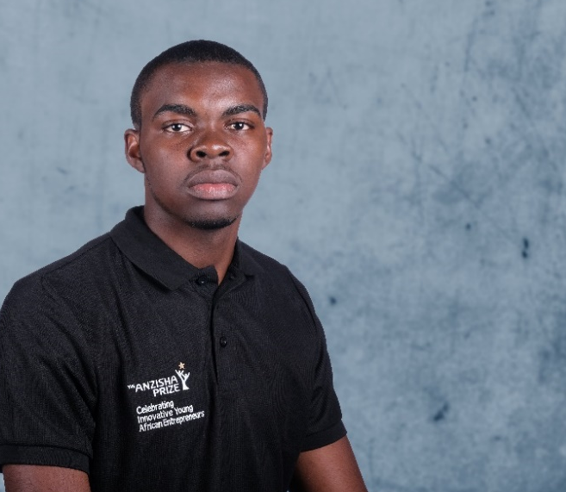
Osvaldo Mokouma – AquagriTech: Agri-Tech and food supply
NAME OF BUSINESS: AquagriTech
BUSINESS ACTIVITIES: AquagriTech supplies healthy, fresh fish, fruits and vegetables all year round.
BUSINESS LOCATION: The Republic of Congo
JOBS CREATED (Full & Part Time): 6
CONTACT DETAILS
Contact: Osvaldo Mokouma
Website: www.aquagritech.com
Email: osvaldoreychrysmokouma@gmail.com WhatsApp: +242 06 650 1574
ABOUT OSVALDO
Osvaldo is the co-founder of AquagriTech. He was initially not interested in agriculture. However, after seeing the high number of imported agricultural goods in his country, he decided to get involved in agriculture. Leveraging off of his digital experience, he built an application that farmers could use for their farming activities. In 2018, he met Merveil Mavoungou and the two of them co-founded AquagriTech

Slide 13
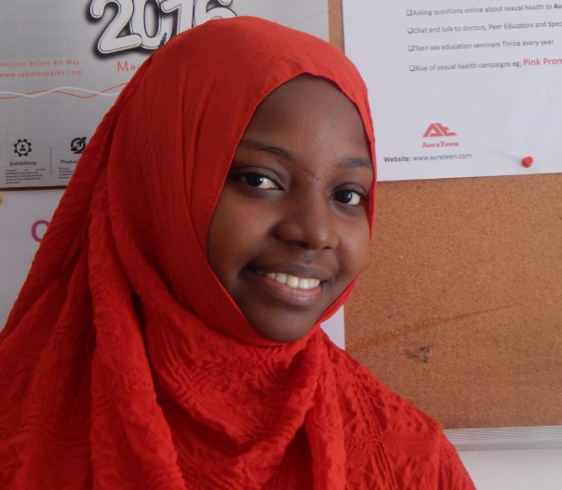
Asha Abbas Kombo – Aura Teens: Health awareness
NAME OF BUSINESS: Aura Teens
BUSINESS ACTIVITIES: Aura Teens is an online platform which educates teenagers about the health risks associated with sex. Together with health practitioners, Aura Teens provides counseling services both online and in person, to educate on topics such as STDs and cervical cancer.
BUSINESS LOCATION: Tanzania
JOBS CREATED (Full & Part Time): 8
CONTACT DETAILS
Contact: Asha Abbas Kombo
Website: https://www.facebook.com/aurateens
Email: usherabbas@gmail.com
WhatsApp: +255 673 007 174
ABOUT ASHA
Asha is a young African leader passionate about technology, leadership, entrepreneurship and the environment. As an agent of change, she founded the Aura Teen sexual health organization. She also co-founded Evergreen – a company that recycles waste into artificial wood and furniture. With a need to enrich her pre-existing leadership experience, she enrolled in African Leadership Academy (South Africa).

Slide 14
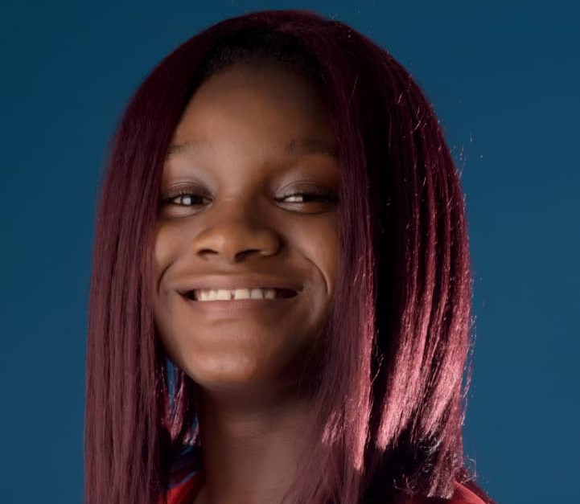
Victoria Olimatunde – BizKids: Financial literacy board game
NAME OF BUSINESS: BizKids
BUSINESS ACTIVITIES: BizKids is a board game designed to teach children about financial literacy, how to save money, and the rudimentary aspects of starting a small scale business in a fun and interactive gamified manner.
BUSINESS LOCATION: Nigeria
JOBS CREATED (Full & Part Time): 4
CONTACT DETAILS
Contact: Victoria Olimatunde
Website: http://bizkids.com
Email: victoriaakinfolarin@gmail.com
WhatsApp: +234 802 373 2526
ABOUT VICTORIA
Victoria is the founder of BizKids. At 15 years old, Victoria was one of the Anzisha Prize’s youngest finalist. She developed the BizKids' board game to address the lack of available Nigerian financial literacy content that is tailored specifically for children's learning needs.

Slide 15
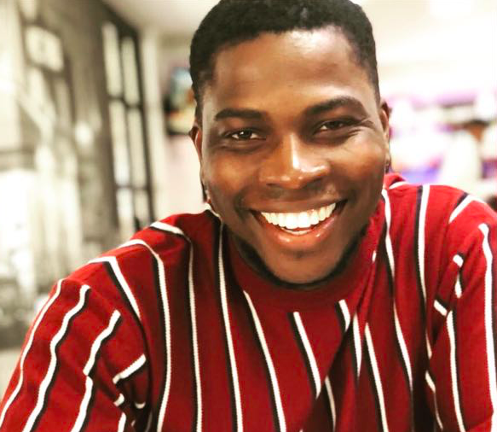
Kolawole Olajide – BridgeLabs: Software development
NAME OF BUSINESS: BridgeLabs
BUSINESS ACTIVITIES: BridgeLabs provides digital transformation services for forward thinking organizations across multiple sectors.
BUSINESS LOCATION: South Africa
JOBS CREATED (Full & Part Time): 20
CONTACT DETAILS
Contact: Kola Olajide
Website: https://bridgelabs.design
Email: kola@bridgelabs.design
WhatsApp: +27 79 942 5095
ABOUT KOLA
Kola co-founded Bridge Labs because of his passion for building high-quality technology products designed to enable forward-thinking organizations to compete and perform in the 21st century. He has extensive experience as the technical lead for several major projects including: The African Leadership University, the University of Pretoria and the Western Cape government. He is a Microsoft technology partner and has received multiple innovation awards—most notably a R500,000 innovation prize at the annual SAB innovation awards and United Nations recognition for best innovation in education.

Slide 16
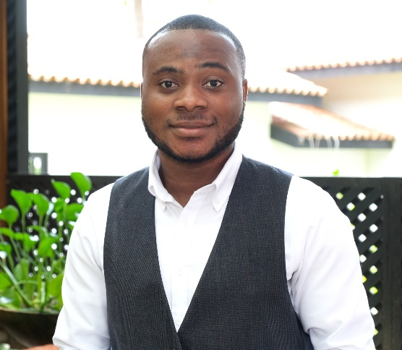
Emmanuel Agyei – Campus Trends Ghana: Marketing & communications
NAME OF BUSINESS: Campus Trends Ghana
BUSINESS ACTIVITIES: Campus Trends Ghana is a marketing firm that provides qualitative advice and communications services to bridge the gap between firms and the student market.
BUSINESS LOCATION: Ghana
JOBS CREATED (Full & Part Time): 605
CONTACT DETAILS
Contact: Emmanuel Agyei
Website: https://www.linkedin.com/in/emmanuel-owusu-agyei-ampem-b64693117/
Email: campustrendgh@gmail.com
WhatsApp: +233 24 634 1762
ABOUT EMMANUEL
Emmanuel Agyei was always interested in journalism especially since his father is a journalist. However, his uncle managed to shift his focus to a world of technology and marketing. It was then he realized the importance of communication and information tools within organizations. Thus, bringing to life Campus Trends Ghana, which he co-founded.

Slide 17
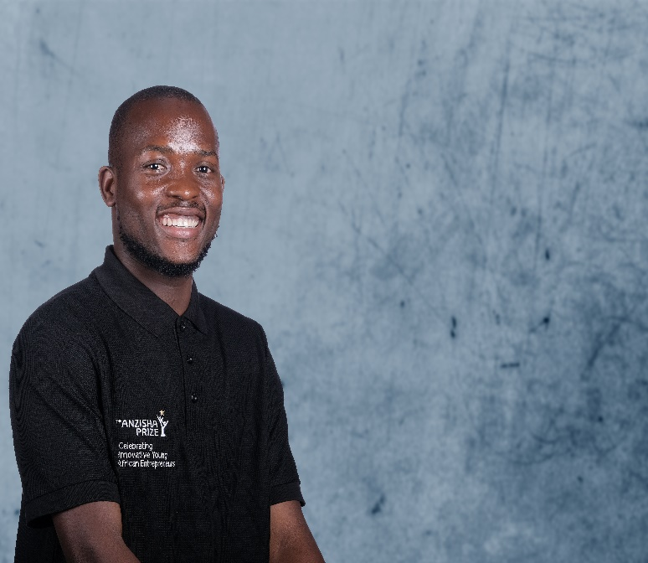
Velache Coker – Canaan Farm Limited: Agri-Tech company
NAME OF BUSINESS: Canaan Farm Limited
BUSINESS ACTIVITIES: Canaan Farm Limited is involved in food production, logistics, fintech, big data, fish smoking, fish farming and horticulture.
BUSINESS LOCATION: Sierra Leone
JOBS CREATED (Full & Part Time): 50
CONTACT DETAILS
Contact: Velache Coker
Website: https://www.linkedin.com/in/velache-coker-00a808195/
Email: Cannan.farm@yahoo.com
WhatsApp: +232 791 750 93
ABOUT VELACHE
Velache wanted to become a professional footballer. However, after some false starts in the football space, he found himself pursuing entrepreneurship. While spending some time in Gambia with his family, he became aware of the agricultural issues within his home country (Sierra Leone). By the age of 19, he had started three businesses but he now only continues to operate Canaan Farm Limited.

Slide 18
Jessan Persand – Crab Aquaculture: Seafood supplier
NAME OF BUSINESS: Crab Aquaculture
BUSINESS ACTIVITIES: Crab Aquaculture is a mud crab farming business, which supplies crabs and other seafood to restaurants and households.
BUSINESS LOCATION: Mauritius
JOBS CREATED (Full & Part Time): 6
CONTACT DETAILS
Contact: Jessan Persand
Website: https://www.linkedin.com/in/jessan-kumar-persand-41b530150/
Email: persandjessan@gmail.com WhatsApp: +256 755 151 527
ABOUT JESSAN
Jessan had always dreamed of launching his own business. He observed that there was a lack of fresh crabs in the local market and then decided to make his dream come true and start his own company through mud crab farming in Mauritius.

Slide 19
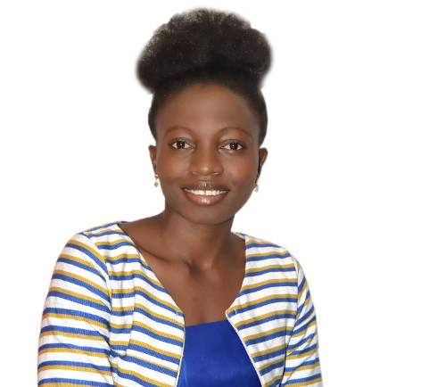
Mabel Suglo – Dignified Wear: Clothing
NAME OF BUSINESS: Dignified Wear
BUSINESS ACTIVITIES: Dignified Wear is a social enterprise that trains and employs people with disabilities and rural women to manufacture durable, versatile and fashionable shoes, handbags, locally woven fabrics and jewellery. The products they sell are made from recycled tires, scrap fabrics, cotton threads, recycled glass and acrylic beads.
BUSINESS LOCATION: Ghana
JOBS CREATED (Full & Part Time): 10
CONTACT DETAILS
Contact: Mabel Suglo
Website: https://dignifiedwear.com/
Email: mabels@dignifiedwear.com WhatsApp: +233 20 742 3532
ABOUT MABEL
Mabel is a social entrepreneur who founded Dignified Wear. Her Grandmother, a single mother who lived with leprosy, was the inspiration for Mabel to start her business and to employ and uplift persons with disabilities and rural women.

Slide 20
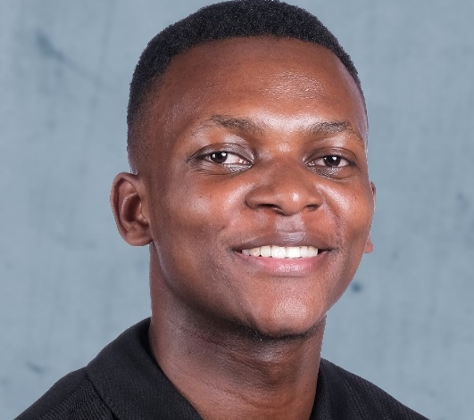
Cecil Chikezie– Eco Makaa: Charcoal briquettes
NAME OF BUSINESS: Eco Makaa
BUSINESS ACTIVITIES: Eco Makaa is a company that connects local fuel briquette producers to a client base by recruiting the community’s small-scale briquette producers who collectively produce standardized briquettes..
BUSINESS LOCATION: Nairobi, Kenya
JOBS CREATED (Full & Part Time): 25
CONTACT DETAILS
Contact: Cecil Chikezie
Website: https://ecomakaa.com
Email: chikezie.cecil@yahoo.com
WhatsApp: +254 701 830 597
ABOUT CECIL
Cecil is a final year Mechanical Engineering student and the founder of Eco Makaa. Cecil discovered that fuel briquettes made from carbonized agricultural refuse were a feasible fuel alternative but they were not easily accessible in the market. Using this information, he decided to start Eco Makaa. During the 2019, Nairobi Innovation Week Cecil received the best student in innovation award. Cecil was also the second runner up at the 2019 Anzisha Prize awards and a finalist for the Global Student Entrepreneurship Awards.

Slide 21
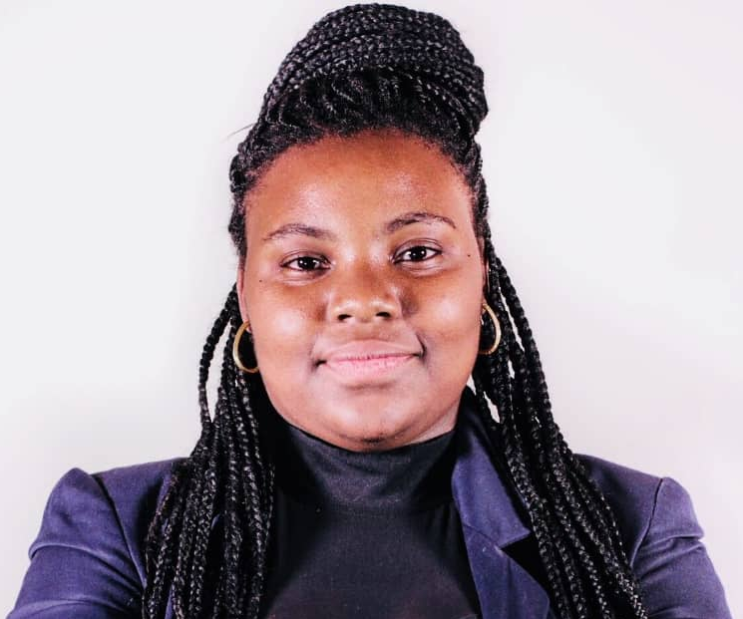
Yaye Souadou Fall – E-Cover: Artificial grounds manufacturing
NAME OF BUSINESS: E-cover
BUSINESS ACTIVITIES: E-cover converts tire waste into artificial grass aggregates, sports flooring and playgrounds.
BUSINESS LOCATION: Senegal
JOBS CREATED (Full & Part Time): 6
CONTACT DETAILS
Contact: Yaye Souadou Fall
Website: https://www.linkedin.com/in/yaye-souadou-fall-b0ab8110b/
Email: mirisoua04@gmail.com WhatsApp: +221 781 790 087
ABOUT YAYE
Yaye is proficient in five different languages and loves doing research. During her explorations, she gained a strong interest in environmentally-friendly technology. Growing up, she could not help but notice how her community was littered with tires and other plastics. Yaya then coupled her knowledge on recycling with the desire to affect positive change and founded E-cover.

Slide 22
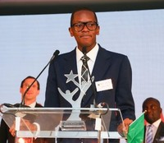
Fabrice Alomo – Epher Foundation: Financial platform
NAME OF BUSINESS: Epher Foundation
BUSINESS ACTIVITIES: Epher is a decentralized financial platform at the intersection of payment, saving, remittance, lending, investment and learning that can be used worldwide by anyone in developing and emerging countries who has a mobile phone.
BUSINESS LOCATION: Cameroon
JOBS CREATED (Full & Part Time): 38
CONTACT DETAILS
Contact: Fabrice Alomo
Website: https://epher.services/epherfoundation
Email: fabricealomo@gmail.com
WhatsApp: +237 700 37 751
ABOUT FABRICE
Fabrice is the founder and CEO of the Epher Foundation and HehFit. He previously founded and was the CEO of AMoney. Fabrice is a fellow of the Tony Elumelu Entrepreneurship Programme, a fellow of the Global Shapers Community of the World Economic Forum, and an Impact Fellow of the Singularity University. He was also named as a “Top 30 under 30 best young entrepreneurs” by Forbes Magazine.

Slide 23
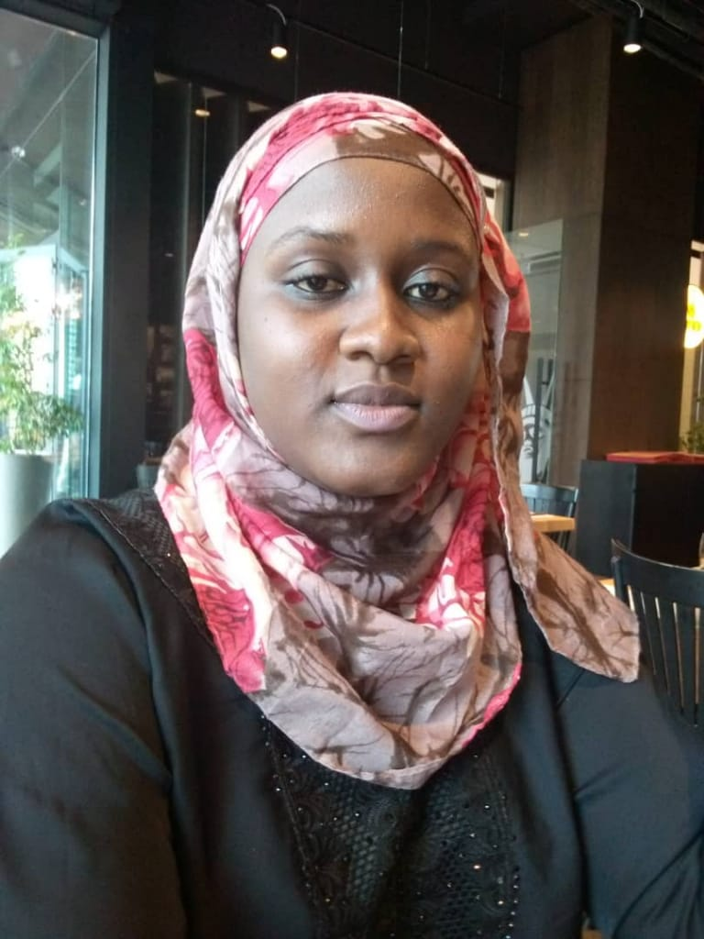
Chamsiya Lamine – E3D-NIGER: Agriculture and cosmetics
NAME OF BUSINESS: E3D-NIGER
BUSINESS ACTIVITIES: E3D-Niger manufacture soaps, insecticides, and natural fertilizers using neem as the main ingredient.
BUSINESS LOCATION: Niger
JOBS CREATED (Full & Part Time): 12
CONTACT DETAILS
Contact: Chamsiya Lamine
Website: https://e3dniger.com
Email: info@e3dniger.com
WhatsApp: +227 963 898 94
ABOUT CHAMSIYA
Chamsiya is the co-founder of E3D-Niger.. She holds a Master’s degree in Telecommunications and Management. She is also a 2016 Anzisha Prize award finalist.

Slide 24
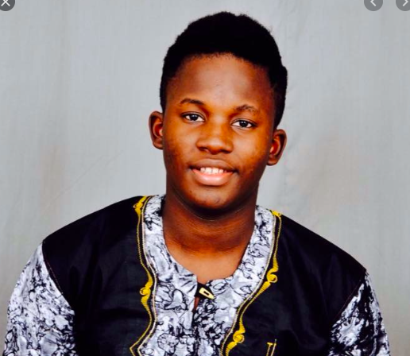
Awah Ntseh – Farmer’s Forte: Skincare manufacturer
NAME OF BUSINESS: Farmer’s Forte
BUSINESS ACTIVITIES: Farmer’s Forte is a heliculture and apiculture business that uses honey and snail mucin to make serum alongside a range of other beauty products, including coconut oil, neem and aloe vera.
BUSINESS LOCATION: Cameroon
JOBS CREATED (Full & Part Time): 13
CONTACT DETAILS
Contact: Awah Ntseh
Website: https://www.facebook.com/farmersforte237
Email: awah.ntseh@yahoo.com
WhatsApp: +237 671 318 350
ABOUT AWAH
Awah’s core passion is to use the gifts that nature gives to solve the challenges that he sees around him. He hopes to raise awareness about the benefits of products derived from natural sources and intends to grow his business beyond the borders of Cameroon.

Slide 25
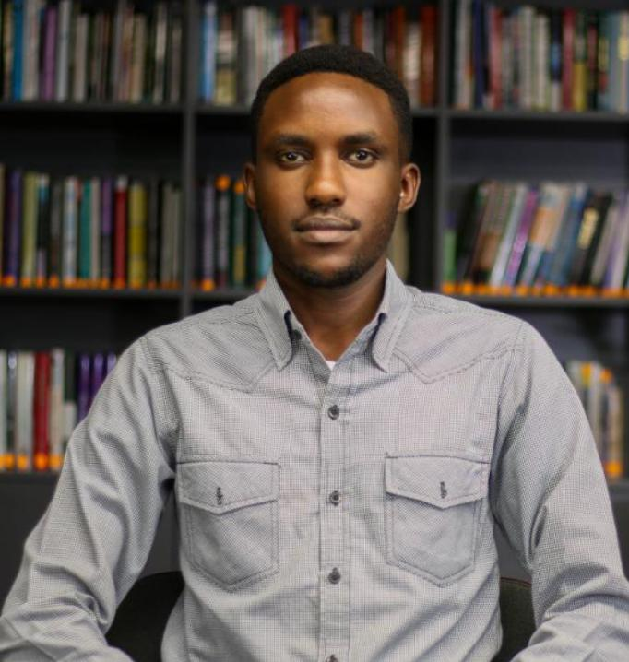
Kevin Kibet – FarmMoja: Avocado farming
NAME OF BUSINESS: FarmMoja
BUSINESS ACTIVITIES: FarmMoja Limited focuses on avocado production and works with smallholder farmers— giving them inputs, training, and access to reliable markets.
BUSINESS LOCATION: Kenya
JOBS CREATED (Full & Part Time): 6
CONTACT DETAILS
Contact: Kevin Kibet
Website:
https://www.linkedin.com/in/kevin-kibet-mochama-29b8ba145/
Email: kkm@farmmoja.org
WhatsApp: +254 799 099 988
ABOUT KEVIN
Kevin is a Bachelor of Commerce graduate. Kevin hopes FarmMoja can become the largest smallholder driven agricultural development company on the continent. His vision is to have a network of a million farmers by 2030..

Slide 26
Heritiana Randriamananatahina– Fiombonana: Agro-processing
NAME OF BUSINESS: Fiombonana MG, FY'DELIKÔ
BUSINESS ACTIVITIES: Fiombonana MG produces, processes, and supplies cheese, chocolate, fruit juice and other dairy products.
BUSINESS LOCATION: Madagascar
JOBS CREATED (Full & Part Time): 41
CONTACT DETAILS
Contact: Heritiana Randriamananatahina
Website: https://www.linkedin.com/in/heritiaina-fabien-randriamananatahina-26544416b/
Email: randriamananatahina.fabien@gmail.com
WhatsApp: +261348982174
ABOUT HERITIANA
At 16, Heritiana dropped out of the sixth grade to work as a water can distributor and then later as a caca-pigeon sales person for his uncle for a year (without pay). Rather than letting his circumstances hinder him, he saw this inconvenience as an opportunity to start his own business, Fiombonana.

Slide 27
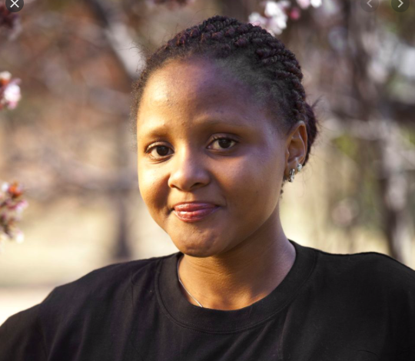
Domitila Silayo – FixChap: Home and office repair services
NAME OF BUSINESS: FixChap
BUSINESS ACTIVITIES: FixChap is a web and mobile App connecting home and office owners with vetted handymen.
BUSINESS LOCATION: Tanzania
JOBS CREATED (Full & Part Time): 6
CONTACT DETAILS
Contact: Domitila Silayo
Website: https://www.fixchap.com
Email: info@fixchap.com
WhatsApp: +255 787 573 397
ABOUT DOMITILA
Domitila has over five years of experience in business and entrepreneurship with a focus on manufacturing, product development, and marketing. She has an MBA from Mzumbe University where she specialized in product operations and corporate management.

Slide 28
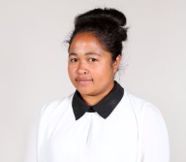
Rebecca Andrianarisandy – GasGasy: Bio-compost and bio-gas
NAME OF BUSINESS: GasGasy
BUSINESS ACTIVITIES: GasGasy provides alternative, affordable, sustainable and environmentally friendly energy for people to cook with, in the form of bio-compost and bio-gas.
BUSINESS LOCATION: Madagascar
JOBS CREATED (Full & Part Time): 6
CONTACT DETAILS
Contact: Rebecca Andrianarisandy
Website: https://www.linkedin.com/in/rebecca-andrianarisandy-784b66199
Email: rebeccaandrianarisandy@gmail.com
WhatsApp: +261 3496 856 15
ABOUT REBECCA
Rebecca and her all-female team decided to create GasGasy to provide a practical solution to the environmental problems we all face today. This together with the excessive exploitation of the forest for charcoal production but also with the ongoing concerns of climate change lead to the creation of GasGasy.

Slide 29
Christian Tesfaye – GebeyaNet: Agricultural E-Commerce
NAME OF BUSINESS: GebeyaNet
BUSINESS ACTIVITIES: GebeyaNet is a web based platform that connects farmers, consumers and transporters. The platform offers services that is inclusive of USSD, a website, a GPS system, SMS services, a call centre and IVR services.
BUSINESS LOCATION: Ethiopia
JOBS CREATED (Full & Part Time): 3
CONTACT DETAILS
Contact: Christian Tesfaye
Website: https://www.linkedin.com/in/christian-tesfaye-41213abb/
Email: christes7@gmail.com WhatsApp: +251 91 354 4259
ABOUT CHRISTIAN
By the age of 17 Christian was a self-taught developer and coder who started his first business, Syntex Systems. Syntex Systems developed various software products including a lightweight cloud-based ERP. At the age of 19, he identified a problem in the agricultural sector and decided to work on a solution that could help farmers and his community- GebeyaNet.

Slide 30
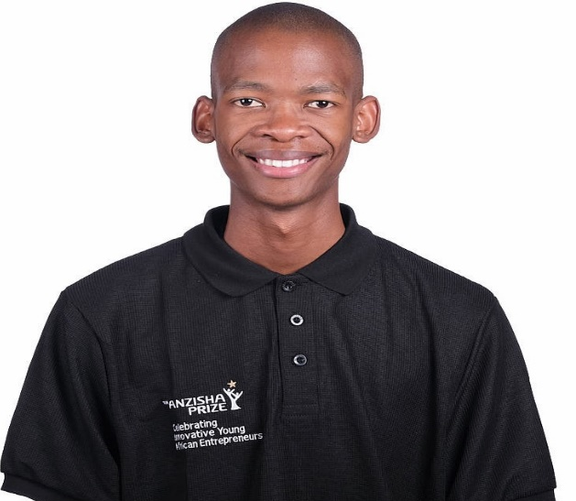
Godiragetse Mogajane – Goodie Tutors: Tutoring services
NAME OF BUSINESS: Goodie Tutors
BUSINESS ACTIVITIES: Goodie Tutors is a tutoring agency which provides exam-focused lessons for primary school, high school, and university students.
BUSINESS LOCATION: South Africa
JOBS CREATED (Full & Part Time): 155
CONTACT DETAILS
Contact: Godiragetse Mogajane
Website: http://goodietutors.co.za/
Email: godiragetse@goodietutors.co.za
WhatsApp: +27 64 618 2246
ABOUT GODIRAGETSE
Godiragetse is deeply passionate about social educational development. He is the founder of Goodie Tutors (Pty) Ltd and is also the brain child behind AskGoodie, a Mathematics and Science call-centre platform which Godiragetse and his small team of Edupreneurs believe will revolutionize the education landscape in South Africa.

Slide 31
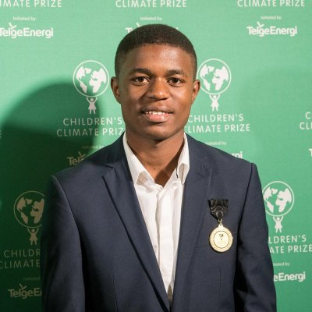
Edgar Edmund – Green Venture Tanzania: Recycled construction material
NAME OF BUSINESS: Green Venture Tanzania
BUSINESS ACTIVITIES: Green Venture recycles plastic waste into cost-effective building products such as paving blocks. The venture also helps people build houses using their cost-effective materials whilst also promoting environmental sustainability.
BUSINESS LOCATION: Tanzania
JOBS CREATED (Full & Part Time): 121
CONTACT DETAILS
Contact: Edgar Edmund
Website: http://www.greenventuretz.com
Email: edgaredmund424@gmail.com WhatsApp: +255 744 404 987
ABOUT EDGAR
Edgar Edmund is the founder of Green Venture Tanzania. After seeing how the rain and floods destroyed houses in his country due to poor foundations and poor building materials, Edgar was inspired to solve this problem by turning adversity into opportunity.

Slide 32
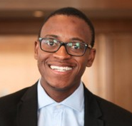
Ludwick Marishane – DryBath (Pty) Ltd: Waterless body wash gel
NAME OF BUSINESS: DryBath (Pty) Ltd
BUSINESS ACTIVITIES: DryBath® Gel is an innovative, waterless body wash gel that cleans your body by using the skin-rubbing motion of your hands to gently remove dead skin cells and your full-body odor. DryBath® Gel is manufactured in South Africa and has been dermatologically tested for safe use on sensitive skin areas and for children aged 3+ years..
BUSINESS LOCATION: South Africa
JOBS CREATED (Full & Part Time): 3
CONTACT DETAILS
Contact: Ludwick Marishane
Website: www.drybathgel.com
Email: Ludwickm@drybathgel.com
WhatsApp: +27 78 635 5818
ABOUT LUDWICK
Ludwick invented a waterless bathing lotion, DryBath®. Ludwick is a TED Speaker and was named the 2011 Global Student Entrepreneur of the Year Award (the first South African to achieve this award). He has also been recognized by TIME Magazine as “30 People under 30 Changing the World” and by Forbes as a “30 under 30 African Entrepreneurs” in 2013.

Slide 33
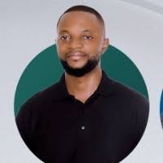
Alain Nteff – Healthlane: Maternal health information platform
NAME OF BUSINESS: Healthlane
BUSINESS ACTIVITIES: Healthlane provides health services like access to doctors and health data, amongst other things to customers via a mobile application. Through one of its apps, GiftedMom, Healthlane has impacted over 500K mothers its across various platforms.
BUSINESS LOCATION: Cameroon
JOBS CREATED (Full & Part Time): 20
CONTACT DETAILS
Contact: Alain Nteff
Website: http://www.giftedmom.org
Email: nteffal@gmail.com
WhatsApp: +237 519 742 64
ABOUT ALAIN
Alain is a social entrepreneur who has a background in telecommunications engineering. He is on a mission to create a world free of maternal and infant deaths by using mobile technology to reach pregnant women and mothers who do not have access to quality healthcare services.

Slide 34
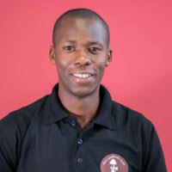
Kisseka Samson – Hello Mushroom: Oyster mushrooms
NAME OF BUSINESS: Hello Mushroom
BUSINESS ACTIVITIES: Hello Mushroom is a co-operative that collaborates with farmers to grow and sell mushrooms. They supply inputs to growers, offer free training, and provide buy-back facilities in exchange for commission.
BUSINESS LOCATION: Uganda
JOBS CREATED (Full & Part Time): 6
CONTACT DETAILS
Contact: Kisseka Samson
Website: https://hellomushrooms.org
Email: kislop@ymail.com
WhatsApp: +256 700 792 168
ABOUT KISSEKA
Kisseka holds a diploma in Agriculture. Upon completing his diploma, Kisseka started exploring business opportunities and discovered mushroom farming was a lucrative yet an underserved area of farming.

Slide 35
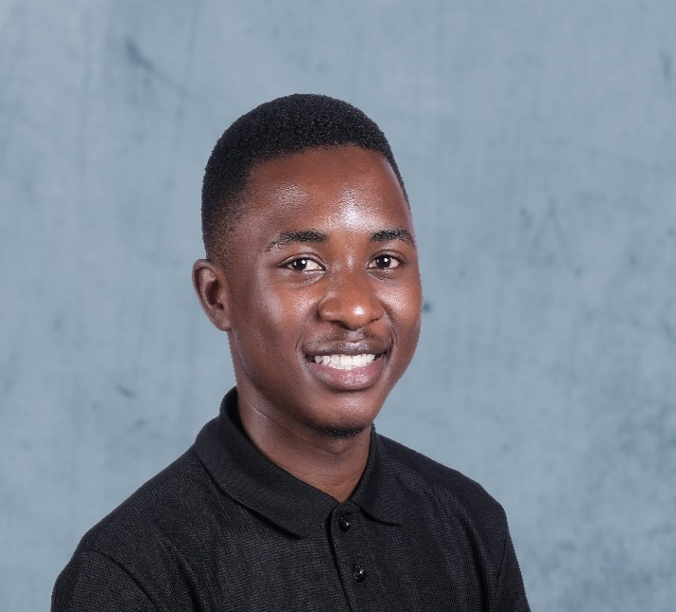
Marvellous Nyongoro – Housing Hub: Off-campus accommodation
NAME OF BUSINESS: Housing Hub
BUSINESS ACTIVITIES: The Housing Hub is a premier online service provision platform that enables tertiary students in Zimbabwe to book and make payments for off-campus accommodation using a smartphone or computer.
BUSINESS LOCATION: Zimbabwe
JOBS CREATED (Full & Part Time): 52
CONTACT DETAILS
Contact: Marvellous Nyongoro
Website: https://thehousinghub.co.zw
Email: marvellousnyongoro@gmail.com
WhatsApp: +263 771 103 511
ABOUT MARVELLOUS
Marvellous is a final year Bachelor of Commerce student, majoring in Accounting at Midlands State University. Following Marvellous' frustration with the lack of off-campus student accommodation available to him and other students at his university, he decided to start the Housing Hub so that he could solve for the lack of available off-campus accommodation.

Slide 36
Balbina Gulam – Huduma Smart: Domestic worker services
NAME OF BUSINESS: Huduma Smart
BUSINESS ACTIVITIES: Huduma Smart is an enterprise that trains domestic workers and provides a job market for them via their website.
BUSINESS LOCATION: Tanzania
JOBS CREATED (Full & Part Time): 107
CONTACT DETAILS
Contact: Balbina Gulama
Website: https://hudumasmart.co.tz/
Email: balbinagullam@gmail.com
WhatsApp: +255 657 336 601
ABOUT BALBINA
Balbina is the founder of Huduma Smart. She is an advocate for equality and is passionate about fair pay, healthy working conditions, and making sure that women are treated with dignity. Balbina has grown to become a proud tech-champion and an inspiring icon to women in her community.

Slide 37
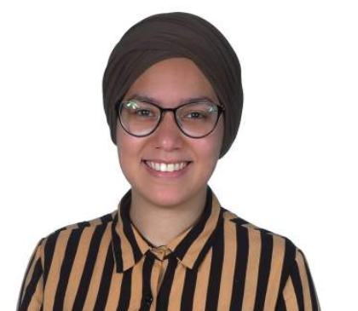
Fadwa Moussaif – IDYR: Fashion accessories business
NAME OF BUSINESS: IDYR
BUSINESS ACTIVITIES: IDYR revives the ancestral history of Berber Boucherouite through fashion accessories and decorative accessories hand-woven from new textile scraps.
BUSINESS LOCATION: Morocco
JOBS CREATED (Full & Part Time): 15
CONTACT DETAILS
Contact: Fadwa Moussaif
Website: https://www.linkedin.com/in/fadwa-moussaif-294373121/
Email: fadwamoussaif95@gmail.com
WhatsApp: +212 654 152 145
ABOUT FADWA
Fadwa is the co-founder of IDYR. IDYR was born out of a chance encounter with women weavers. When she was a little girl, she used to draw designs of dresses (kaftans). She has a passion for drawing, design and ancestral history.

Slide 38
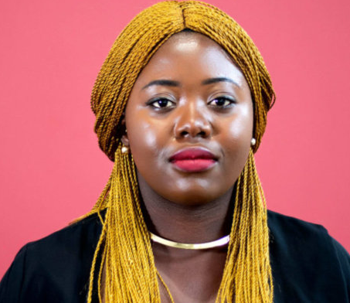
Melissa Bime – Infiuss: Online blood bank
NAME OF BUSINESS: Infiuss (Online Blood Bank)
BUSINESS ACTIVITIES: Infiuss is a digital blood bank management platform and an emergency blood sourcing and delivery service, that connects hospitals with blood banks to hospitals without blood banks and patients in need of blood transfusions.
BUSINESS LOCATION: Cameroon, Ivory Coast
JOBS CREATED (Full & Part Time): 10
CONTACT DETAILS
Contact: Melissa Bime
Website: https://infiuss.org
Email: mjbime@infiuss.org
WhatsApp: +237 714 623 22
ABOUT MELISSA
Melissa is a nursing graduate and the founder of INFIUSS. Melissa founded INFIUSS after her experience of working in a hospital and witnessing too many patients dying as a result of hospitals failing to source compatible blood for life-saving transfusions.

Slide 39
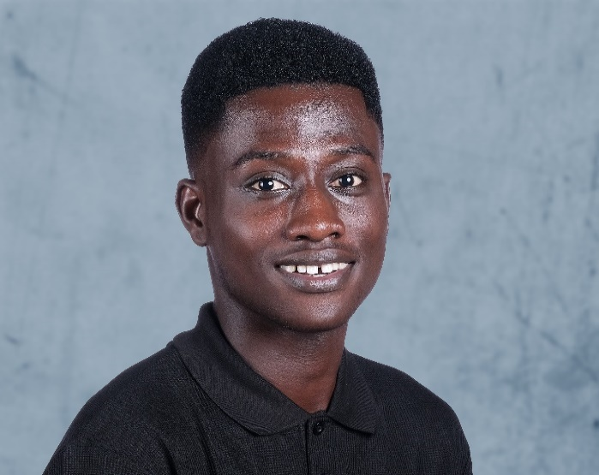
Caleb Annobil – IYC Life Company: Customised sachet water
NAME OF BUSINESS: IYC Life Company
BUSINESS ACTIVITIES: IYC Life Company (High School Water Project) is an enterprise that customizes sachet water to sell to students at affordable prices.
BUSINESS LOCATION: Ghana
JOBS CREATED (Full & Part Time): 7
CONTACT DETAILS
Contact: Caleb Annobil
Website:
https://annobilcaleb.wixsite.com/iyclifecompany
Email: annobilcaleb@gmail.com
WhatsApp: +233 269 820 908
ABOUT CALEB
Caleb is the co-founder of IYC Life Company. Caleb became aware of the dangers of unclean water after the death of his friend due to cholera and with his own difficulty in accessing clean water. Subsequently, Caleb went on to draft ideas on how to provide clean water to young people. Together with his co-founder, Youseff, the High School Water Product was founded.

Slide 40
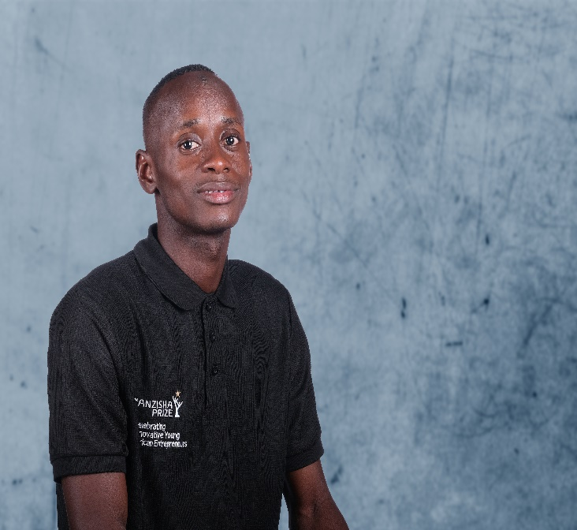
Mamadjang Jallow – Jallow Trading: Horticultural products supplier
NAME OF BUSINESS: Jallow Trading Vegetables Farm
BUSINESS ACTIVITIES: Jallow Trading is rural horticultural farm that produces organic fruits and vegetables in different varieties and sells it to local markets, restaurant, households and agricultural merchants in the Gambia.
BUSINESS LOCATION: Gambia
JOBS CREATED (Full & Part Time): 14
CONTACT DETAILS
Contact: Mamadjang Jallow
Website: https://twitter.com/JallowFarm
Email: jallowtradingvegetablefarm@gmail.com
WhatsApp: +220 342 32 57
ABOUT MAMADJANG
Mamadjang was a university student who had a growing need to support his community. As a result of his tertiary education, he started his agricultural business, Jallow Trading. At the age of 15, Mamadjang became aware of the need for more jobs and gainful employment in his home country (Gambia). It seemed natural for him to follow his parents’ footsteps and to become involved in farming.

Slide 41
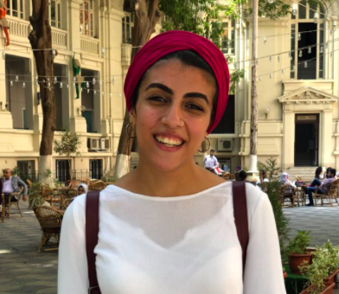
Farah Emara – JIDAR: Indoor & outdoor tailored wall art services
NAME OF BUSINESS: JIDAR
BUSINESS ACTIVITIES: JIDAR recruits artists to paint customized murals and re-design interiors for various businesses.
BUSINESS LOCATION: Egypt
JOBS CREATED (Full & Part Time): 32
CONTACT DETAILS
Contact: Farah Emara
Website: https://www.jidar.ma
Email: farahemara@jidarwallart.com
WhatsApp: +20 112 841 1125
ABOUT FARAH
Farah is an artist and student from Cairo with a deep desire to uplift the creative economy in Egypt. She is the founder of Jidar Wall. In recognition of her work, Farah was named one of “25 under 25” entrepreneurs reinventing Egypt by startupscene.com in 2017.

Slide 42
Graff Accrombessi – Kawan Africa: Food processing company
NAME OF BUSINESS: Kawan Africa
BUSINESS ACTIVITIES: Kawan Africa is an enterprise which produces and sells tomato puree. The company also sets up workshops to train young women to produce the puree and the young women become wholesalers of Kawan Africa’s products.
BUSINESS LOCATION: Benin
JOBS CREATED (Full & Part Time): 8
CONTACT DETAILS
Contact: Graff Accrombessi
Website: https://facebook.com/KawanAfrica
Email: kawanafrica@gmail.com
WhatsApp: +229 617 510 37
ABOUT GRAFF
Graff has a high school diploma in Food Technology and is currently studying Food Safety and Nutrition. After analyzing the situation in Benin, where poverty was more prominent among women and at the same time significant food is wasted, she co-founded Kawan Africa.

Slide 43
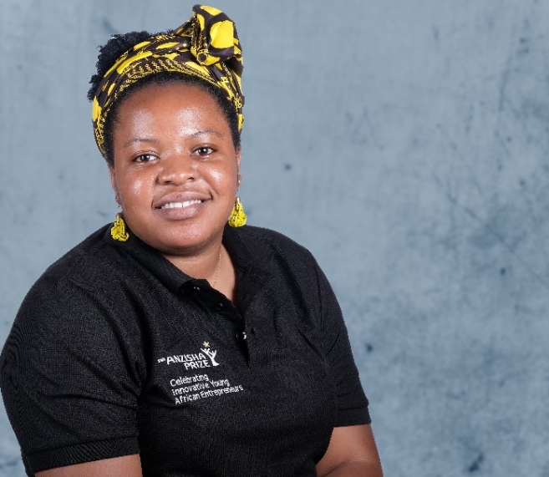
Yannick Kimanuka – KIM'S: Kindergarten & primary education
NAME OF BUSINESS: Complexe Scolaire KIM'S
BUSINESS ACTIVITIES: Complexe Scolaire KIM'S is a nursery and primary school which aims to reduce the trend of intellectual disability found in children from her community.
BUSINESS LOCATION: Democratic Republic of Congo
JOBS CREATED (Full & Part Time): 13
CONTACT DETAILS
Contact: Yannick Kimanuka
Website: https://www.linkedin.com/in/yannick-kimanuka-b864b5192/
Email: yannickkims5@gmail.com WhatsApp: +243 995 840 830
ABOUT YANNICK
Yannick holds a Bachelor's degree in Business Administration. Her childhood significantly influenced her passion for entrepreneurship. She created KIM’S to enable her community, which had been affected by the ongoing wars, to have access to quality education. Yannick was the 2019 Anzisha Grand Prize winner and has also been awarded many other national prizes.

Slide 44
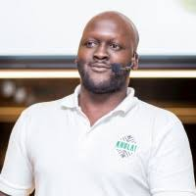
Karidas Tshintsholo– KHULA!: Platform connecting farmers and buyers
NAME OF BUSINESS: Khula
BUSINESS ACTIVITIES: Khula is an integrated platform that connects producers to customers who are looking for locally grown fresh produce right from the soil (market access). Khula also provides a shared cold chain through a driver app.
BUSINESS LOCATION: South Africa
JOBS CREATED (Full & Part Time): 14
CONTACT DETAILS
Contact: Karidas Tshintsholo
Website: https://www.khula.com
Email: karidast@khula.com
WhatsApp: +27 79 388 7439
ABOUT KARIDAS
Karidas is an experienced entrepreneur and co-founder of Khula. He is the previous founder of MoneyTree Group, a business in the banking and education sector. Karidas is a proud product of the township from which he was raised.

Slide 45
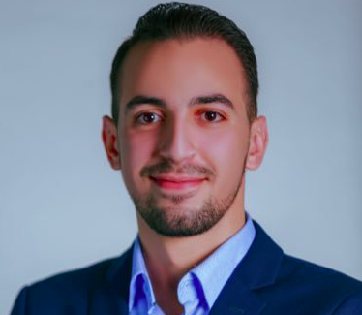
Issam Darui – Lagare.me: Digital bus ticket booking platform
NAME OF BUSINESS: Lagare.me
BUSINESS ACTIVITIES: Lagare.ma enables customers to find, compare, and book inter-city bus tickets (across Morocco) online.
BUSINESS LOCATION: Morocco
JOBS CREATED (Full & Part Time): 6
CONTACT DETAILS
Contact: Issam Darui
Website: https://www.lagare.ma
Email: issam@lagare.ma
WhatsApp: +212 661 770883
ABOUT ISSAM
Issam studied economics at the Universite Mohammed Premier-Oujda. At 13 years old, his elder brother became a professional bus driver. Soon afterwards, Issam started working as a driver’s assistant during the holidays. His experiences resulted in his desire to establish Lagare.ma, the first electronic bus station in Morocco. Lagare.me was selected as one of the Top 5 Best Start-ups in Morocco and was also recognized as the best e-commerce platform in Morocco.

Slide 46
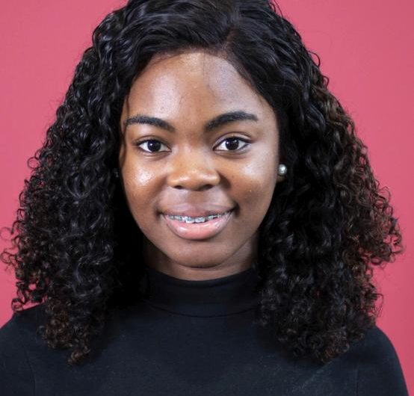
Lourena Bundi– L&C Buffet Infantil: Event management
NAME OF BUSINESS: L&C Buffet Infantil
BUSINESS ACTIVITIES: L&C Buffett Infantil provides customized birthday party experiences for kids.
BUSINESS LOCATION: Angola
JOBS CREATED (Full & Part Time): 22
CONTACT DETAILS
Contact: Lourena Bundi
Website: https://instagram.com/lcbuffetinfantil
Email: lourenabundi@gmail.com
WhatsApp: +244 933 048 533
ABOUT LOURENA
Lourena is the founder of L&C Buffet Infantil. She has a knack for identifying opportunities in areas that are not always easily evident. In 2015, after her cousin had asked her to organize a baby shower, Lourena realized that there is a limited number of party planners who specialize in creating parties for young children in Angola. She quickly realized she could apply her organizational and creative skills to bridge the gap with the creation of L&C Buffet Infantil.

Slide 47
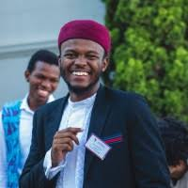
Jesse Forrester – Mazi: Green technology catalysing the transport industry
NAME OF BUSINESS: Mazi
BUSINESS ACTIVITIES: Mazi is a locally engineered green technology company which hopes to be a vehicle in catalyzing the sustainability of the African transport industry.
BUSINESS LOCATION: Nairobi, Kenya
JOBS CREATED (Full & Part Time): 2
CONTACT DETAILS
Contact: Jesse Forrester
Website: https://www.linkedin.com/in/jesse-forrester
Email: Jesse.forrrester@gmail.com
WhatsApp: +254 713230264
ABOUT JESSE
Jesse is passionate about entrepreneurship, finance, technology and public speaking. He is a public speaker and has participated in events such as TEDx, the Anzisha Prize, and the Abu Dhabi Sustainability Week. Jesse hopes that Mazi will inspire youth to use green business and green initiatives to transform Africa.

Slide 48
Andrew Ddembe – MobiKlinic: Healthcare provider for rural areas
NAME OF BUSINESS: MobiKlinic
BUSINESS ACTIVITIES: MobiKlinic Uganda is developing an app that can be used to make emergency appointments via a toll-free number that will be directly linked to a mobile van clinic offering door-to-door services in rural areas.
BUSINESS LOCATION: Uganda
JOBS CREATED (Full & Part Time): 68
CONTACT DETAILS
Contact: Andrew Ddembe
Website: https://ug.linkedin.com/in/andrew-ddembe-a55524124
Email: ddembe.andrew@gmail.com
WhatsApp: +256 700 218 686
ABOUT ANDREW
Andrew recently founded MobiKlinic Uganda with the support of Sandoz (a Novartis division). He was selected as one of the three winners of the 2019 Sandoz Healthcare Access Challenge. Prior to this, he founded a conglomerate of businesses called Heart for the Hurt (textile making, restaurants, and coffee production). His aim is to combat the high rate of unemployment in Uganda by employing young people.

Slide 49
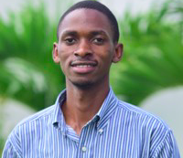
Noah Walakira – Namirembe Sweater Makers: School uniform manufacturer
NAME OF BUSINESS: Namirembe Sweater Makers
BUSINESS ACTIVITIES: Namirembe Sweater Makers
is a registered community based organization that consists of youth and women producing and selling sweaters, head gears, scuffs and other crafts such as paper-neck-laces, bundles, bags and baskets.
BUSINESS LOCATION: Uganda
JOBS CREATED (Full & Part Time): 20
CONTACT DETAILS
Contact: Noah Walakira
Website: https://youtu.be/XRnnpsLnY3o
Email: noah.walakira@gmail.com
WhatsApp: +230 576 036 87
ABOUT NOAH
Noah founded the Namirembe Sweater Makers as he was eager to tackle the growing unemployment in his community. Using his knitting skills that were taught to him by his late grandmother, and by using the earnings that he generated from petty jobs, he started a community-based organization that knits sweaters to combat unemployment. Some of the earnings generated from knitting sweaters were used to put himself and other employees through school.

Slide 50
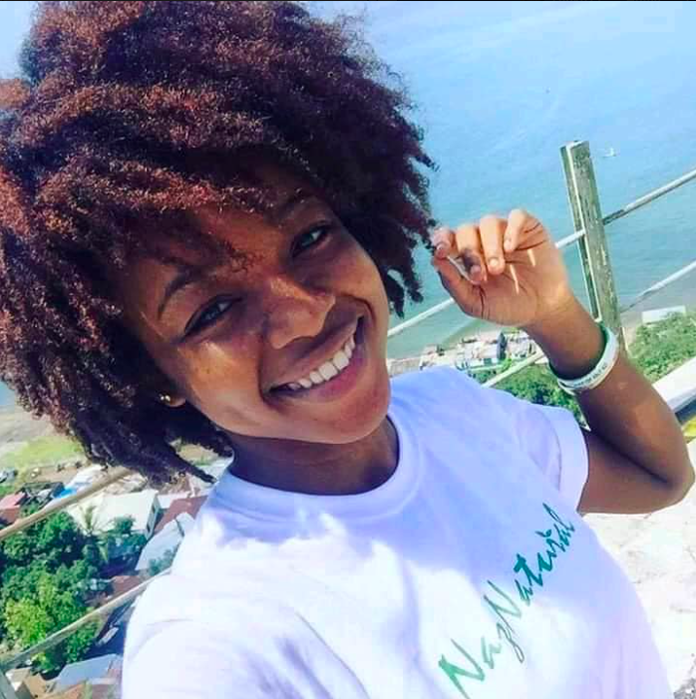
Satta Wahab – Naz Naturals: Natural hair-care manufacturer
NAME OF BUSINESS: Naz Naturals
BUSINESS ACTIVITIES: Naz Naturals produces organic natural Shea-based hair care products to unleash the beauty and confidence in everyone that uses them.
BUSINESS LOCATION: Liberia
JOBS CREATED (Full & Part Time): 7
CONTACT DETAILS
Contact: Satta Wahab
Website: https://naznaturals.com
Email: satta@naznaturals.com
WhatsApp: +231 77 035 4442
ABOUT SATTA
Satta has built one of Liberia’s fast-rising companies, Naz Naturals, a natural hair-care manufacturing company. She noticed there was a gap in the market, after she ‘went natural’ herself. Trying to find the products she needed for this transition, she realized that the products for natural hair in Liberia were all imported and super expensive so she did her research and started making her own products. She has a BSc majoring in Economics and Supply Chain Management from the United Methodist University.

Slide 51
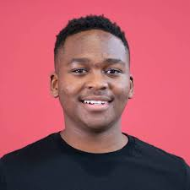
Thando Hlongwane– Nisa Finance: Automating loan applications
NAME OF BUSINESS: Nisa Finance
BUSINESS ACTIVITIES: Nisa Finance automates key steps in the loan application process on behalf of financiers to decrease costs, risks and to improve the client experience for small business borrowers.
BUSINESS LOCATION: South Africa
JOBS CREATED (Full & Part Time): 4
CONTACT DETAILS
Contact: Thando Hlongwane
Website: https://nisafinance.com
Email: thandolwethumz@live.com
WhatsApp: +27 62 401 6153
ABOUT THANDO
Thando is a Computer Science graduate who is passionate about using technology to solve African problems. He abelieves that small and medium enterprises (SMEs) hold the power to grow the South African economy and in using technology to help SMEs grow.

Slide 52
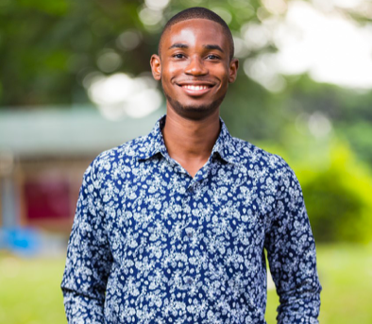
Benedict Ampofo – Nova Agrisystems: Agriculture
NAME OF BUSINESS: Nova Agrisystems
BUSINESS ACTIVITIES: Nova Agrisystems is a demonstration farm designed to create sustainable agricultural communities by providing the requisite skills, knowledge, and innovative technology, helping participating farmers improve their agricultural yield through practice based learning.
BUSINESS LOCATION: Ghana
JOBS CREATED (Full & Part Time): 7
CONTACT DETAILS
Contact: Benedict Ampofo
Website: https://facebook.com/novaagrisystems
Email: ampofo.bka@gmail.com
WhatsApp: +233 138 2059
ABOUT BENEDICT
Benedict is a medical school graduate from Ghana and has always seen himself as a budding social entrepreneur. Coming from a low-income family, he has an itching desire to help families like his. His love for agriculture was heightened while visiting Ghanaian farms and this resulted in him starting Project Kiriku (his demonstration farm).

Slide 53
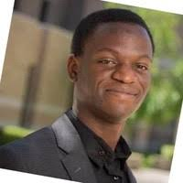
George Bakka– Patasente: Neobank for businesses
NAME OF BUSINESS: Patasente
BUSINESS ACTIVITIES: Patasente is a a neobank for small and medium sized enterprises (SMEs), traders and freelancers, aimed to make trade easier in Africa.
BUSINESS LOCATION: Uganda
JOBS CREATED (Full & Part Time): 8
CONTACT DETAILS
Contact: George Bakka
Website: https://patasente.com
Email: bakkarian@patasente.com
WhatsApp: +255 657 336 601
ABOUT GEORGE
George is a passionate Afrocentric entrepreneur who over the last five years has led initiatives geared towards providing finance and business development support to SMEs in East Africa. He is also the CEO and Founder of Angels Initiative, a leading impact investment firm in East Africa that is turning ideas into high impact Pan-African companies.

Slide 54
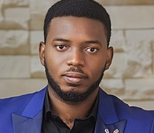
Chukwuwezam Obanor – PrepClass: Tutoring services
NAME OF BUSINESS: PrepClass
BUSINESS ACTIVITIES: Prepclass is an edutech company that connects learners with qualified tutors. They also register students for IELTS, provide in-centre tutorials for IELTS, GMAT, GRE, TOEFL and SAT examinations across various centres in Lagos.
BUSINESS LOCATION: Nigeria
JOBS CREATED (Full & Part Time): 700
CONTACT DETAILS
Contact: Chukwuwezam Obanor
Website: https://prepclass.com.ng/
Email: wezam@prepclassng.com WhatsApp: +234 708 439 9842
ABOUT CHUKWUWEZAM
Chukwuwezam built an online platform to aid Nigerian high school students in revision for national exams. At 21 years, his passion for solving problems resulted in building the framework for an online education platform which is now known as PrepClass. He was recognized by Forbes as one of the Top 30 Most Promising Young Entrepreneurs in Africa in 2016.

Slide 55
David Morfaw – Poult Vault: Poultry services company
NAME OF BUSINESS: Poult Vault
BUSINESS ACTIVITIES: Poult Vault is a poultry company that provides good quality and affordable poultry inputs to small-scale farmers.
BUSINESS LOCATION: Cameroon
JOBS CREATED (Full & Part Time): 4
CONTACT DETAILS
Contact: David Morfaw
Website: www.poultvault.com
Email: dempseymorfaw@yahoo.com WhatsApp: +237 650 093 050
ABOUT DAVID
David is the founder and managing director of Poult Vault. He has received national and international awards because of the success of Poult Vault. David decided to start Poult Vault when he realised that the poultry sector could provide job opportunities for people living in his community.

Slide 56
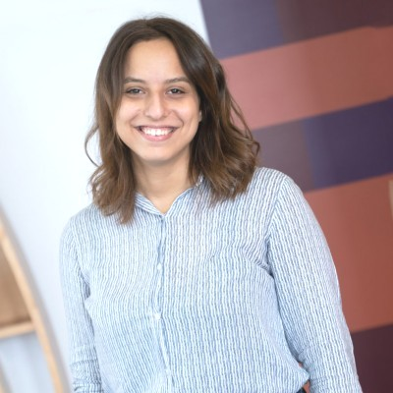
Raghda Medhat – Remoteplatz Egypt: Digital recruitment platform
NAME OF BUSINESS: Remoteplatz Egypt
BUSINESS ACTIVITIES: Remoteplatz connects software engineers who are seeking work experience with international early-stage start-ups through practical remote internships and job opportunities..
BUSINESS LOCATION: Egypt
JOBS CREATED (Full & Part Time): 12
CONTACT DETAILS
Contact: Raghda Medhat
Website: https://www.remoteplatz.com
Email: raghdamadhat12@gmail.com
WhatsApp: +20 111 481 1055
ABOUT RAGHDA
Raghda’s has a Bachelor’s degree majoring in Economics from Cairo University. During her time at university, she was heavily involved with activities and clubs that empowered students to gain knowledge and practical experience. Her time spent working in a few start-ups gave her the idea to start a business that connects talent with global opportunities through remote work.

Slide 57
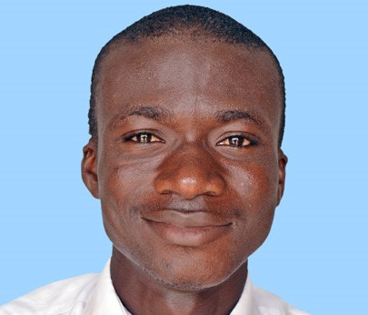
Gabriel Kombassere – Ribla Neda: Organic Food processing
NAME OF BUSINESS: Ribla Neda Burkina Sarl
BUSINESS ACTIVITIES: Ribla Neda produces and sells organic agricultural products. The business also offers other services such as home farming training, transformation, and the development of e-agriculture websites.
BUSINESS LOCATION: Burkina Faso
JOBS CREATED (Full & Part Time): 60
CONTACT DETAILS
Contact: Gabriel Kombassere
Website: https://www.facebook.com/Ribla-Neda-Burkina-Sarl-453348081867611/
Email: kombavongoethe@hotmail.fr WhatsApp: +226 712 24 161
ABOUT GABRIEL
Gabriel is a social entrepreneur, who founded Ribla Neda – a community based organization that tackles poverty and hunger in Africa. He founded CJAB, the Club for the youngest authors of Burkina Faso, in 2016 and co-founded GAMEG-Zeitschrift (a student newspaper) in 2018.

Slide 58
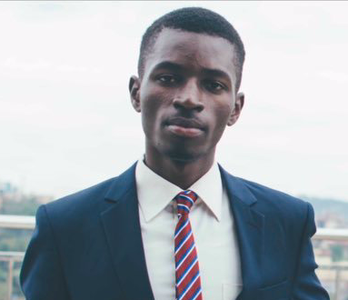
Daniel Musika – RideLink: B2B transport sharing network
NAME OF BUSINESS: RideLink
BUSINESS ACTIVITIES: RideLink is a ride-sharing platform that offers tailor-made transport solutions to SMEs and corporates in emerging markets.
BUSINESS LOCATION: Uganda
JOBS CREATED (Full & Part Time): 21
CONTACT DETAILS
Contact: Daniel Mukisa
Website: https://ride-link.com
Email: Daniel@ride-link.com
WhatsApp: +256 706 525 830
ABOUT DANIEL
Daniel has five years of experience in the transportation industry (this includes a year working for Uber Technologies). He is also a co-founder of Transporter, a leading logistics company that provides deliveries for e-commerce businesses. As a community role model, he carries out environmental sustainability activities to offset the emissions of his transportation activities. His ambition is to expand the business to hire more youth through new customer acquisition, fleet expansion, and completion of an online transportation booking mobile application and system.

Slide 59
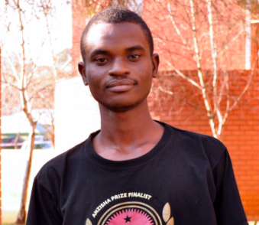
Mahmood Oyewo – RubiQube: Engagement-based advertising platform
NAME OF BUSINESS: RubiQube
BUSINESS ACTIVITIES: Rubiqube is an advertising technology company that provides video and other rich media to drive customer engagement for its clients.
BUSINESS LOCATION: Nigeria
JOBS CREATED (Full & Part Time): 32
CONTACT DETAILS
Contact: Mahmood Oyewo
Website: https://therubiqube.com
Email: mahmood@therubiqube.com
WhatsApp: +234 816 577 0916
ABOUT MAHMOOD
Mahmood studied Technology Entrepreneurship at Stanford University, Digital Marketing at Colombia Business School (Emeritus Institute of Management), and a BSc in Computer Engineering at Obafemi Awolowo University. He previously worked as a software developer at Interswitch Ltd and as a Technology Lead at Ofserv Nigeria Ltd. He was recognized by Forbes Africa as one of the 30 Under 30 young African change makers in 2018. He is a member of DEMO Africa (Class of 2016).

Slide 60
Alhaji Siraj Bah– Rugsal Trading: Briquettes, paper bags and poultry
NAME OF BUSINESS: Rugsal Trading
BUSINESS ACTIVITIES: Rugsal Trading produces handcrafted paper bags and briquettes for cooking fuel. In 2020, Rugsal Trading added poultry to its product offering.
BUSINESS LOCATION: Sierra Leone
JOBS CREATED (Full & Part Time): 20
CONTACT DETAILS
Contact: Alhaji Siraj Bah
Website: https://facebook.com/Rugsal
Email: rugsaltrading2017@gmail.com
WhatsApp: +260 96 374 1831
ABOUT ALHAJI
Alhaji was born in a small town in the Eastern Province of Sierra Leone. At 18 and with only $20 in savings, the Sierra Leonean founded Rugsal Trading, an enterprise that now employs 38 people. His inspiring life story was featured on CNN’s Call to Earth in 2019.

Slide 61
Farai Munjoma– Shasha Network: Digital learning platform
NAME OF BUSINESS: Shasha Network
BUSINESS ACTIVITIES: Shasha Network is an edtech startup which provides digital learning to high school students in Zimbabwe. The company aims to provide affordable and innovative high impact education solutions to African communities.
BUSINESS LOCATION: Zimbabwe
JOBS CREATED (Full & Part Time): 8
CONTACT DETAILS
Contact: Farai Munjoma
Website: https://shashanetwork.com
Email: faraimunjoma4@gmail.com
WhatsApp: +230 574 856 26
ABOUT FARAI
Farai is a seasoned social entrepreneur who founded Shasha Network in 2014. He recently graduated from the African Leadership University where he completed a degree in Business Management. He has worked in seven African countries with organizations such as Ashinaga, Junior Achievement, and Eneza Education. He aspires to advise regional African governments on education policy whilst fostering technology partnerships between Africa and advanced economies.

Slide 62
Mohamed Sherif – Sherif Ice Flakes: Refrigeration for fresh seafood
NAME OF BUSINESS: Sherif Ice Flakes BUSINESS ACTIVITIES: Sherif Ice Flakes creates and sells ice flakes in boxes that fisherman can use to refrigerate their catch while they are out at sea.
BUSINESS LOCATION: Libya
JOBS CREATED (Full & Part Time): 2
CONTACT DETAILS
Contact: Mohamed Sherif
Website:
https://www.facebook.com/Sherif-ICE-Flakes-313521306128350/
Email: md.sherif@yahoo.com
WhatsApp: +218 913 636 300
ABOUT MOHAMED
Nicknamed “the philosopher” by his friends for his thoughtful nature, Mohamed has always had a penchant for deep reflection about the challenges and opportunities facing his community. Living close to the seaside in Libya, Mohamed noticed that the fishermen who went out to sea were incurring financial losses because their catch would get spoilt while they are out at sea. To solve this challenge, he started creating and selling ice flakes in boxes that fisherman can use to refrigerate their catch while they are out at sea.

Slide 63
Chris Kwekowe– Slatecube: SaaS-based talent accelerator
NAME OF BUSINESS: Slatecube
BUSINESS ACTIVITIES: Slatecube develops the continent's young talents into world class professionals while it also provides smart AI-based tools to help businesses integrate top
entry-level talents into their workforce.
BUSINESS LOCATION: Nigeria and South Africa
JOBS CREATED (Full & Part Time): 8
CONTACT DETAILS
Contact: Chris Kwekowe
Website: https://www.slatecube.com
Email: chris@slatecube.com
WhatsApp: +234 802 608 2044
ABOUT CHRIS
Chris is a young, MIT-trained, and innovative edtech entrepreneur who is passionate about technology and bettering the prospects for an average African youth. Chris has a keen interest and substantial knowledge in computers and technology. He has a flair for building scalable learning pedagogy and systems tailored to the workforce of today and to that of the future. He was recognized by Forbes Africa in their 30 Under 30 list in 2018.

Slide 64
George Mtemahanji – SunSweet Solar: Energy and Solar company
NAME OF BUSINESS: SunSweet Solar
BUSINESS ACTIVITIES: SunSweet Solar Limited is an energy and solar company, which designs and installs off-grid, mini, and micro grid solar systems.
BUSINESS LOCATION: Tanzania
JOBS CREATED (Full & Part Time): 15
CONTACT DETAILS
Contact: George Mtemahanji
Website: https://www.sunsweetsolarltd.com
Email: george@sunsweetsolarltd.com
WhatsApp: +417 882 541 33
ABOUT GEORGE
In 2003, nine-year-old George Mtemahanji left his home in Ifakara, a small rural town in Tanzania’s Kilombero District, to move to Italy where his mother had managed to secure work. He returned to his birth town after eight years and was surprised to see that it faced the same problems it had when he left. A lack of reliable electricity had in many ways pushed the brakes on development and prevented local industries from reaching their full potential. Subsequently, he is on a mission to provide low cost, clean energy to rural communities across Africa so that the continent can reach its full development potential.

Slide 65
Ifrah Arab– Supermom: Empowering underemployed women
NAME OF BUSINESS: SuperMom
BUSINESS ACTIVITIES: SuperMom is a social enterprise that is committed to enabling and empowering unemployed and underemployed women from marginalized communities. They do this by creating a sales force that distributes essential lifesaving products within their communities.
BUSINESS LOCATION: Kenya
JOBS CREATED (Full & Part Time): 6
CONTACT DETAILS
Contact: Ifrah Arab
Website: https://www.facebook.com/SuperMomKE
Email: ifreitsarab@gmail.com
WhatsApp: +254 711 347 697
ABOUT IFRAH
Ifrah is the founder and CEO of SuperMom. She is a University of Nairobi Law graduate (with LLB honors). Ifrah was born and raised in a marginalized community. Subsequently, her greatest passion is to improve her community and to especially improve the lives of women in her community by empowering them to earn a living.

Slide 66
Bénédicte Mundele – Surprise Tropicale: Fresh fruits and Vegetables
NAME OF BUSINESS: Surprise Tropicale
BUSINESS ACTIVITIES: Surprise Tropicale is a juice bar chain that also delivers fruits and vegetables to clients' homes.
BUSINESS LOCATION: Democratic Republic of Congo
JOBS CREATED (Full & Part Time): 10
CONTACT DETAILS
Contact: Bénédicte Mundele
Website: https://surprisetropicale.yinezo.com
Email: benesthermundele@gmail.com WhatsApp: +243 858 849 700
ABOUT BENEDICTE
Benedicte is the co-founder and CEO of Surprise Tropicale. She has a Master’s degree in Food Innovation. She has been featured in several magazine publications - Forbes, Venture Africa, How We Made It in Africa, Go ladies and Jeune Afrique. In 2019, the BBC recognized her as one of the 100 most influential women in the world.

Slide 67
Boluwatife Omotoyo – Tab Ng: Digital repairs and services
NAME OF BUSINESS: Tab Ng
BUSINESS ACTIVITIES: Tab Ng is an online and offline platform that connects customers with trusted repairers for their digital gadget repair needs. They also sells gadgets as well as offer top up and swap services.
BUSINESS LOCATION: Nigeria
JOBS CREATED (Full & Part Time): 5
CONTACT DETAILS
Contact: Bolutwatife Omotoyo
Website:
https://tab-xi.now.sh
Email: omotayo.boluwatife@gmail.com
WhatsApp: +234 813 750 1834
ABOUT BOLUWATIFE
Boluwatife developed a keen interest in technology at the age of 16. Through Tab Ng, Boluwatife is applying his IT expertise to solve a problem of market access for small scale repairers who fix electronics, while enabling customers to find efficient and reliable artisans to fix their gadgets. He is committed to using technology to create social impact.

Slide 68
Geoffrey Mulei – Tanda: Digital financial services
NAME OF BUSINESS: Tanda
BUSINESS ACTIVITIES: Tanda provides essential digital financial services such as banking, insurance, and utility payments to unreached markets by using micro-retailers.
BUSINESS LOCATION: Kenya
JOBS CREATED (Full & Part Time): 46
CONTACT DETAILS
Contact: Geoffrey Mulei
Website: https://www.tanda.africa
Email: geoff@tanda.africa
WhatsApp: +254 718 318 029
ABOUT GEOFFREY
Geoffrey is a serial entrepreneurial having started his first business at 17 and successfully exiting it at 21. He started his most recent business, Tanda, because he was inspired by his childhood experience of working as a shopkeeper’s assistant. This experience gave him a first-hand view of the day-to day-realities in the life of a shop owner. He witnessed how important shopkeepers are to African neighbourhoods and was inspired to to solve the financial challenges that shopkeepers face by providing them with accessible financial services.

Slide 69
Wuntia Gomda – The Living Machine: Biological waste water treatment plan
NAME OF BUSINESS: The Living Machine
BUSINESS ACTIVITIES: The Living Machine is a biological wastewater treatment plant that recycles over 1,000 liters of waste water daily at the African Leadership Academy’s Johannesburg campus.
BUSINESS LOCATION: Kenya and Ghana
JOBS CREATED (Full & Part Time): 2
CONTACT DETAILS
Contact: Wuntia Gomda
Website: https://www.youtube.com/watch?v=xeGxE_AyoB4
Email: wgomda1@gmail.com
WhatsApp: +233 20 005 1812
ABOUT WUNTIA
Wuntia is the co-founder of The Living Machine. Him and his team won a grant of US $100,000 from the Zayed Sustainability Prize, an international prize for recognizing achievements in sustainability, to construct The Living Machine. He is currently a Special Projects Intern at Safi Sana Holding BV (Ghana) where he is gaining experience in waste-to-energy processes while he investigates potential opportunities for The Living Machine.

Slide 70
Aly Abdelazem – Teens Club: Youth skills development
NAME OF BUSINESS: Teens Club
BUSINESS ACTIVITIES: Teens Club is a youth-led organization that builds the capacity of young women and teens by developing their employment skills, entrepreneurial ability, and innovation by promoting active citizenship.
BUSINESS LOCATION: Egypt
JOBS CREATED (Full & Part Time): 17
CONTACT DETAILS
Contact: Aly Abdelazem
Website: https://teensclubeg.com
Email: aly@teensclubeg.com WhatsApp: +49 157 308 699 46
ABOUT ALY
Aly is an impact-oriented social entrepreneur and non-formal education advocate from Egypt who is currently based in Germany. His social entrepreneurial spirit emerged at the age of 16 when he founded Teens Club. Teens Club is the first Egyptian social enterprise which focuses on non-formal education solutions for less privileged teenagers and women. He is currently studying for a Bachelor’s degree in Bioengineering at the Rhine-Waal University.

Slide 71
Khaled Aboshady – Teradix: Online procurement platform
NAME OF BUSINESS: Teradix
BUSINESS ACTIVITIES: Teradix is a digital marketplace that connects buyers with the right suppliers by simplifying and fostering the process of getting competitive quotations. BUSINESS LOCATION: Egypt
JOBS CREATED (Full & Part Time): 12
CONTACT DETAILS
Contact: Khaled Aboshady
Website: https://teradix.com
Email: khaled.aboshady@teradix.com
WhatsApp: +20 106 338 8873
ABOUT KHALED
Khaled is the CEO of Teradix. He has been recognized by Forbes as one of the most promising young business leaders in Africa. He has a Bachelor's degree in Computer Engineering from Menoufia University and studied Entrepreneurship and Innovation at Kelley School of Business, Indiana University.

Slide 72
Faustino Quissico– TQ Group Services: Hardwood flooring
NAME OF BUSINESS: TQ Group Services
BUSINESS ACTIVITIES: TQ Group Services is a construction company that produces hardwood floors (using locally-sourced raw materials) and provides pool construction and maintenance services.
BUSINESS LOCATION: Mozambique
JOBS CREATED (Full & Part Time): 21
CONTACT DETAILS
Contact: Faustino Quissico
Website:
https://www.linkedin.com/in/faustino-quissico-6154b5114/
Email:
quissico.faustino@gmail.com
WhatsApp: +258 841 069 054
ABOUT FAUSTINO
Faustino is the co-founder of the TQ Group Services. He was born and raised in Maputo by his maternal grandparents. Harnessing his entrepreneurial drive, with the desire to start something different, he brainstormed business ideas with one of his friends. In 2015, they came up with the idea to start TQ Group Services..

Slide 73
Abdulwaheed Alayande – TrepLabs: Builds low-cost clinical tools
NAME OF BUSINESS: TrepLabs
BUSINESS ACTIVITIES: TrepLabs is designed to provide and build low-cost clinical tools that aid in infusion therapy. Their first product, the Realdrip Device, is a non-invasive device that makes blood transfusion and drip treatment simpler and enables automation of the treatment process.
BUSINESS LOCATION: Nigeria
JOBS CREATED (Full & Part Time): 7
CONTACT DETAILS
Contact: Abdulwaheed Alayande
Website: https://treplabs.co
Email: abiola@treplabs.co
WhatsApp: +234 806 353 7984
ABOUT ABDULWAHEED
Abdulwaheed is the founder of TrepLabs. He believes that he is the bridge between technology and people. Curious about how technology will influence and shape the future, Abdulwaheed is confident that we will see that impact that technology can have in healthcare and he wants to be at the centre of that discovery.

Slide 74
Saudah Birungi – Tusafishe: Automated low-cost water filters
NAME OF BUSINESS: Tusafishe
BUSINESS ACTIVITIES: Tusafishe produces automated low-cost filters to provide safe drinking water for large communities. BUSINESS LOCATION: Uganda
JOBS CREATED (Full & Part Time): 9
CONTACT DETAILS
Contact: Saudah Birungi
Website: https://tusafishe.com
Email: saudah@tusafishe.com
WhatsApp: +256 786 261 502
ABOUT SAUDAH
Saudah is the co-founder and Sales and Marketing Director of Tusafishe. She is a graduate in Social Entrepreneurship from the School of Social Innovation and is currently studying for a degree in Business Administration. In 2012, her brother passed away because of diarrhoea (caused by the lack of access to clean water in his school). From then on she vowed to make sure school children, homes, and communities like hers would have access to clean water.

Slide 75
Koffi N’guessan – TYEGRO-CI: Agri-food supplier
NAME OF BUSINESS: TYEGRO-CI
BUSINESS ACTIVITIES: TYEGRO-CI is a company that operates in the agro-industry field and is distinguished by its agricultural innovation.
BUSINESS LOCATION: Ivory Coast
JOBS CREATED (Full & Part Time): 48
CONTACT DETAILS
Contact: Koffi N’guessan
Website: https://www.linkedin.com/in/koffi-jacques-n-guessan-607966144/
Email: nfo.tyegroci@gmail.com
WhatsApp: +225 065 799 19
ABOUT KOFFI
Koffi is the founder of TYEGRO-CI. He was born to a farmer and a housewife. Growing up, he gained his primary education at the EPP in Dabouyo. He was appointed by the president of the school to raise funds for two years in order to build three classrooms– an experience that hallmarked the start of his entrepreneurial leadership journey. He has won many prizes in his country and across the African continent because of his innovative approach to agri-food supply.

Slide 76
Joan Nalubega– Uganics: Mosquito repellent soap and products
NAME OF BUSINESS: Uganics
BUSINESS ACTIVITIES: Uganics combats malaria by producing a long-lasting mosquito repellent soap that can be used by children and families for both bathing and washing linen.
BUSINESS LOCATION: Uganda
JOBS CREATED (Full & Part Time): 6
CONTACT DETAILS
Contact: Joan Nalubega
Website: https://www.uganics.org/
Email: uganics@gmail.com
WhatsApp: +256 705 553 704
ABOUT JOAN
Growing up in an orphanage, Joan often found herself falling ill with Malaria. After receiving social entrepreneurship training, Joan was inspired to create a venture that would tackle the disease that she had constantly battled with in her younger years. Subsequently, she started Uganics to tackle malaria, a disease that is still pervasive in Uganda.

Slide 77
Ibrahima Konate – Volaille d'Or: Poultry & agri-foods supplier
NAME OF BUSINESS: Volaille d'Or
BUSINESS ACTIVITIES: Volaille d'Or produces and distributes fresh poultry products and agro-foods. Their products are slaughtered, cleaned, packaged and delivered all in the same day. The company specializes in the production and distribution of agri-food products and they aim to sell chicken at competitive prices directly to consumers.
BUSINESS LOCATION: Ivory Coast
JOBS CREATED (Full & Part Time): 30
CONTACT DETAILS
Contact: Ibrahima Konate
Website: https://facebook.com/volailledor
Email: benazizkonate@gmail.com
WhatsApp: +225 773 191 00
ABOUT IBRAHIMA
Ibrahima is the manager and founder of Volaille d'Or. His inspiration for this business came from a documentary in which he saw that the Ivory Coast continues to import poultry and he saw that there a gap in the market that needed to be fulfilled. He has a Master's degree in Business Management. He was the winner of the 2017 Anzisha Grand Prize and was recognized by Forbes as one of the 30 most promising young Africans in 2018.

Slide 78
Emmanuel Okon– Vmedkit: Mental health services
NAME OF BUSINESS: Vmedkit
BUSINESS ACTIVITIES: Vmedkit seeks to address mental health illness by using Virtual Reality technology. The rationale for this form of cognitive-behavioral psychotherapy is that exposing the patient to the target source or context of their condition combined with relaxation and mindfulness training.
BUSINESS LOCATION: Nigeria
JOBS CREATED (Full & Part Time): 14
CONTACT DETAILS
Contact: Emmanuel Okon
Website: http://www.vmedkit.com/
Email: okon.emma0@gmail.com
WhatsApp: +234 810 777 0124
ABOUT EMMANUEL
Emmanuel is one of a few African innovators who has founded a startup that has been supported by Facebook. He suffered from mental health issues growing up and after experiencing and seeing the pitfalls of mental healthcare in Nigeria, he founded Vmedkit to address psychiatric disorders in mentally ill persons. He intends to improve the stigma surrounding mental health matters in Nigeria – a calling that motivated him to decline an offer to study a Master’s degree in Canada and to rather pursue an entrepreneurial career.

Slide 79
Catherine Nalukwago – Vertical and Micro Gardening: Agricultural Inputs
NAME OF BUSINESS: Vertical and Micro Gardening (VMG)
BUSINESS ACTIVITIES: VMG manufactures and supplies vertical farms to aid low income and urban households so that these households can grow their own food using the smallest available land.
BUSINESS LOCATION: Uganda
JOBS CREATED (Full & Part Time): 7
CONTACT DETAILS
Contact: Catherine Nalukwago
Website: https://nguvu.africa/insights/profile?p=1059
Email: nalukwagocatherine0@gmail.com WhatsApp: +256 702 233 236
ABOUT CATHERINE
Catherine is the co-founder of Vertical and Micro Gardening. Catherine fell into entrepreneurship through her interest in agriculture in Uganda. While at university, she and two other friends wanted to help impoverished urban households grow their food through sack gardening.

Slide 80
Elizabeth Skosana– We Like Cake: Cakery
NAME OF BUSINESS: We Like Cake
BUSINESS ACTIVITIES: We Like Cake is a cakery based in Johannesburg that creates unique baked goods, serving the wider Johannesburg region. They operate a shop in Booysen and have an online platform where one can place orders for delivery or pick up.
BUSINESS LOCATION: South Africa
JOBS CREATED (Full & Part Time): 3
CONTACT DETAILS
Contact: Elizabeth Skosana
Website: https://www.welikecake.com
Email: liz@welikecake.com
WhatsApp: +27 74 672 3653
ABOUT ELIZABETH
Elizabeth is a Master of Social Work graduate. She is the Founder and CEO of We Like Cake, which was established in 2017. Liz aspires to leave the world better than she found it, and aims to inspire, create and share the resource and knowledge that she has acquired on her journey through life.

Slide 81
Chineyenwa Onu – Waste or Create Hub: Space for sustainable innovations
NAME OF BUSINESS: Waste or Create Innovation Hub
BUSINESS ACTIVITIES: Waste Or Create Innovation Hub is an inclusive, technical, and practical space for sustainable innovations.
BUSINESS LOCATION: Ghana
JOBS CREATED (Full & Part Time): 15
CONTACT DETAILS
Contact: Chineyenwa Onu
Website: https://instagram.com/wasteorcreate
Email: chineyenwa.onu@gmail.com
WhatsApp: +233 20 809 8238
ABOUT CHINEYENWA
Chineyenwa believes that the missing ingredient in Africa is the ability of its people to become problem solvers and innovators. Over a seven-year period, she has founded and led three organizations that continuously develop a new cohort of people who can find new solutions and synergies for Africa’s development. These three organizations are Waste or Create Hub, Startup Africa Network, and The Enabler Consultancy.

Slide 82
Thowiba Alhaj – Vintage: Clothing brand
NAME OF BUSINESS: Vintage
BUSINESS ACTIVITIES: Vintage is a women clothing brand that resells unique vintage clothing items, which come from local markets, to eco-conscious customers who want to save money. The proceeds from sales go towards supporting women who work in the local vintage clothing markets.
BUSINESS LOCATION: Sudan
JOBS CREATED (Full & Part Time): 5
CONTACT DETAILS
Contact: Thowiba Alhaj
Website: https://linkedin.com/in/thowiba-alhaj-b603651a3/
Email: thowibaalhag@gmail.com
WhatsApp: +249 91 144 4116
ABOUT THOWIBA
Thowiba defines herself as an entrepreneur, environmentalist, and fashion lover. She is driven and passionate about youth and women empowerment. She previously founded Work Jump-Up Sudan, an organization that empowers university students by linking them to much-needed job opportunities. She is currently studying towards a Bachelor's degree in Medicine.

Slide 83
Andrew Mupuya – YELI: Manufacturer of paper envelopes & grocery bags
NAME OF BUSINESS: YELI
BUSINESS ACTIVITIES: YELI manufactures eco-friendly envelopes and grocery paper bags and for individuals and organizations. The company’s products can be found in supermarkets, restaurants, and medical centers in Kampala.
BUSINESS LOCATION: Uganda
JOBS CREATED (Full & Part Time): 45
CONTACT DETAILS
Contact: Andrew Mupuya
Website: www.yelipaperbags.com
Email: mupuyaandrew@yelipaperbags.com
WhatsApp: +256 771 498 459
ABOUT ANDREW
Andrew saw a market opportunity in manufacturing paper bags due to the Ugandan government leaning towards banning the use of polythene plastic bags. He now oversees the production of eco-friendly paper bags, that exceeds 60 tons per month, which have been sold locally (Uganda) and to Kenya, Norway, and the USA. Andrew has twice been named by Forbes as one of the top 30 African entrepreneurs below the age of 30 and was the 2012 Anzisha Grand Prize Winner.

Slide 84
Vanessa Ishimwe – YIDA: Early childhood education
NAME OF BUSINESS: YIDA- Youth Initiative for Development in Africa
BUSINESS ACTIVITIES: YIDA bridges the gap by providing free Early Childhood Education to refugee children through special learning centers and schools. The organization has so far opened three learning centers that have educated 600 children, while also employing 26 refugee youth as teachers.
BUSINESS LOCATION: Uganda
JOBS CREATED (Full & Part Time): 28
CONTACT DETAILS
Contact: Vanessa Ishimwe
Website: https://youthinitiativefda.org
Email: ivanyshe25@gmail.com
WhatsApp: +256 770 884 547
ABOUT VANESSA
Vanessa is a Rwandan national who grew up in Kyaka refugee Camp in Uganda. Having experienced the challenges of trying to access education in the refugee camp, Vanessa decided she wanted to do something to bring opportunity to young people living in refugee camps.

Slide 85
Jariatou Jallow – Yonima Errands Runner: Administration & delivery service
NAME OF BUSINESS: Yonima Errands Runner
BUSINESS ACTIVITIES: Yonima Errands provides business and personal errands services such as business registration, bank account registration, and shopping pick-up and delivery for households and businesses.
BUSINESS LOCATION: Gambia
JOBS CREATED (Full & Part Time): 4
CONTACT DETAILS
Contact: Jariatou Jallow
Website: https://yonimaerrandsrunner.com
Email: yonimasendme@gmail.com
WhatsApp: +220 319 94 69
ABOUT JARIATOU
Jariatou Jallow is a third-year Computer Science student at the University of The Gambia. Jariatou helped launch Door Step Express as the first courier service in Gambia. Motivated by the success of Door Step Express, Jariatou decided to start Yonima Errands Runner.

Slide 86
Alina Karimamusama – Yoni Wash: Feminine hygiene products
NAME OF BUSINESS: Yoni Wash Zambia
BUSINESS ACTIVITIES: Yoni Wash is a range of organic intimate hygiene washes for women. Yoni Wash has created a range of six products to caters for the diverse needs of women. Yoni Wash is sold in Zambia and has distributors in South Africa, Namibia, and Malawi.
BUSINESS LOCATION: Zambia
JOBS CREATED (Full & Part Time): 14
CONTACT DETAILS
Contact: Alian Karimamusama
Website:
https://instagram.com/yonisteamzambia
Email: alina.m.kari@gmail.com
WhatsApp: +260 963 741 831
ABOUT ALINA Alina is driven to solve the challenges of gender inequality and economic marginalization facing women and youth in Zambia. She founded The Women’s Economic Empowerment Project when she was 16 years old; a social enterprise that equips women with sustainable development skills and strives to end poverty. Alina went on to launch Yoni Wash in 2019.

Slide 87
Thank You

